Slide 1
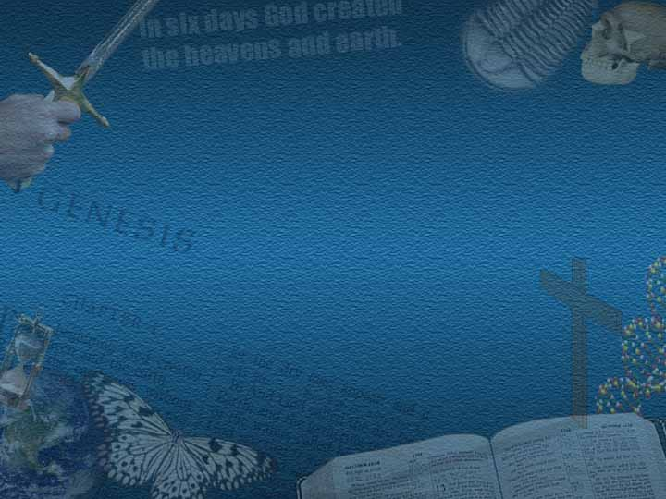

DISCOVER
CREATION
LANNY & MARILYN JOHNSON
ALPHA OMEGA INSTITUTE
P.O. Box 4343 • Grand Junction, CO • 81502
(970) 523-9943 • www.discovercreation.org

Slide 2

CREATION
EVOLUTION
M049

Slide 3
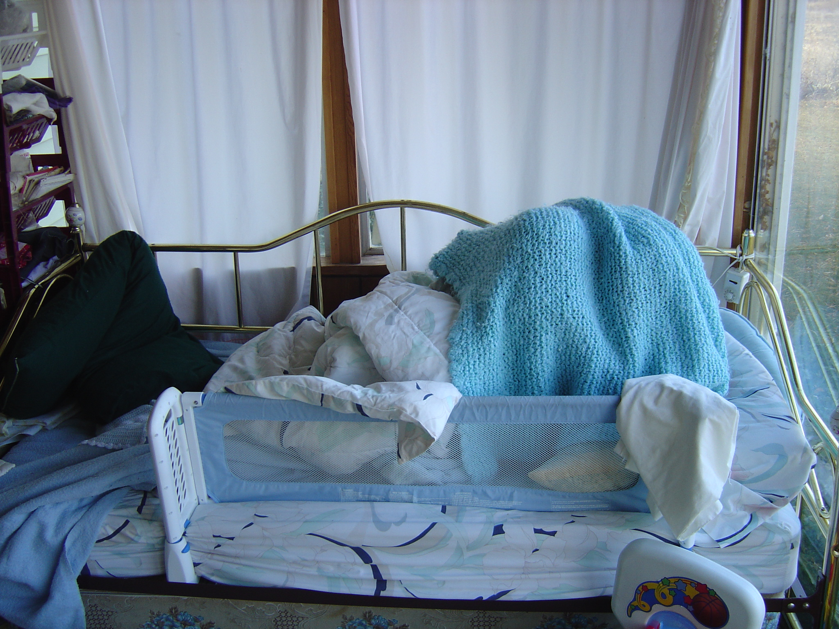
Notes:
For children, the point of hide-and-go-seek is not so much hiding as it is being found. I have a grandson who loves to play hide-and-go-seek, but he’s not very good at it. When I close my eyes and start to count, they dash across the house and hide in exactly the same spot they hid in last time. And if I say, “I wonder where Thad is?” He’ll pop up and yell, “Here I am Pappa!”

Slide 4
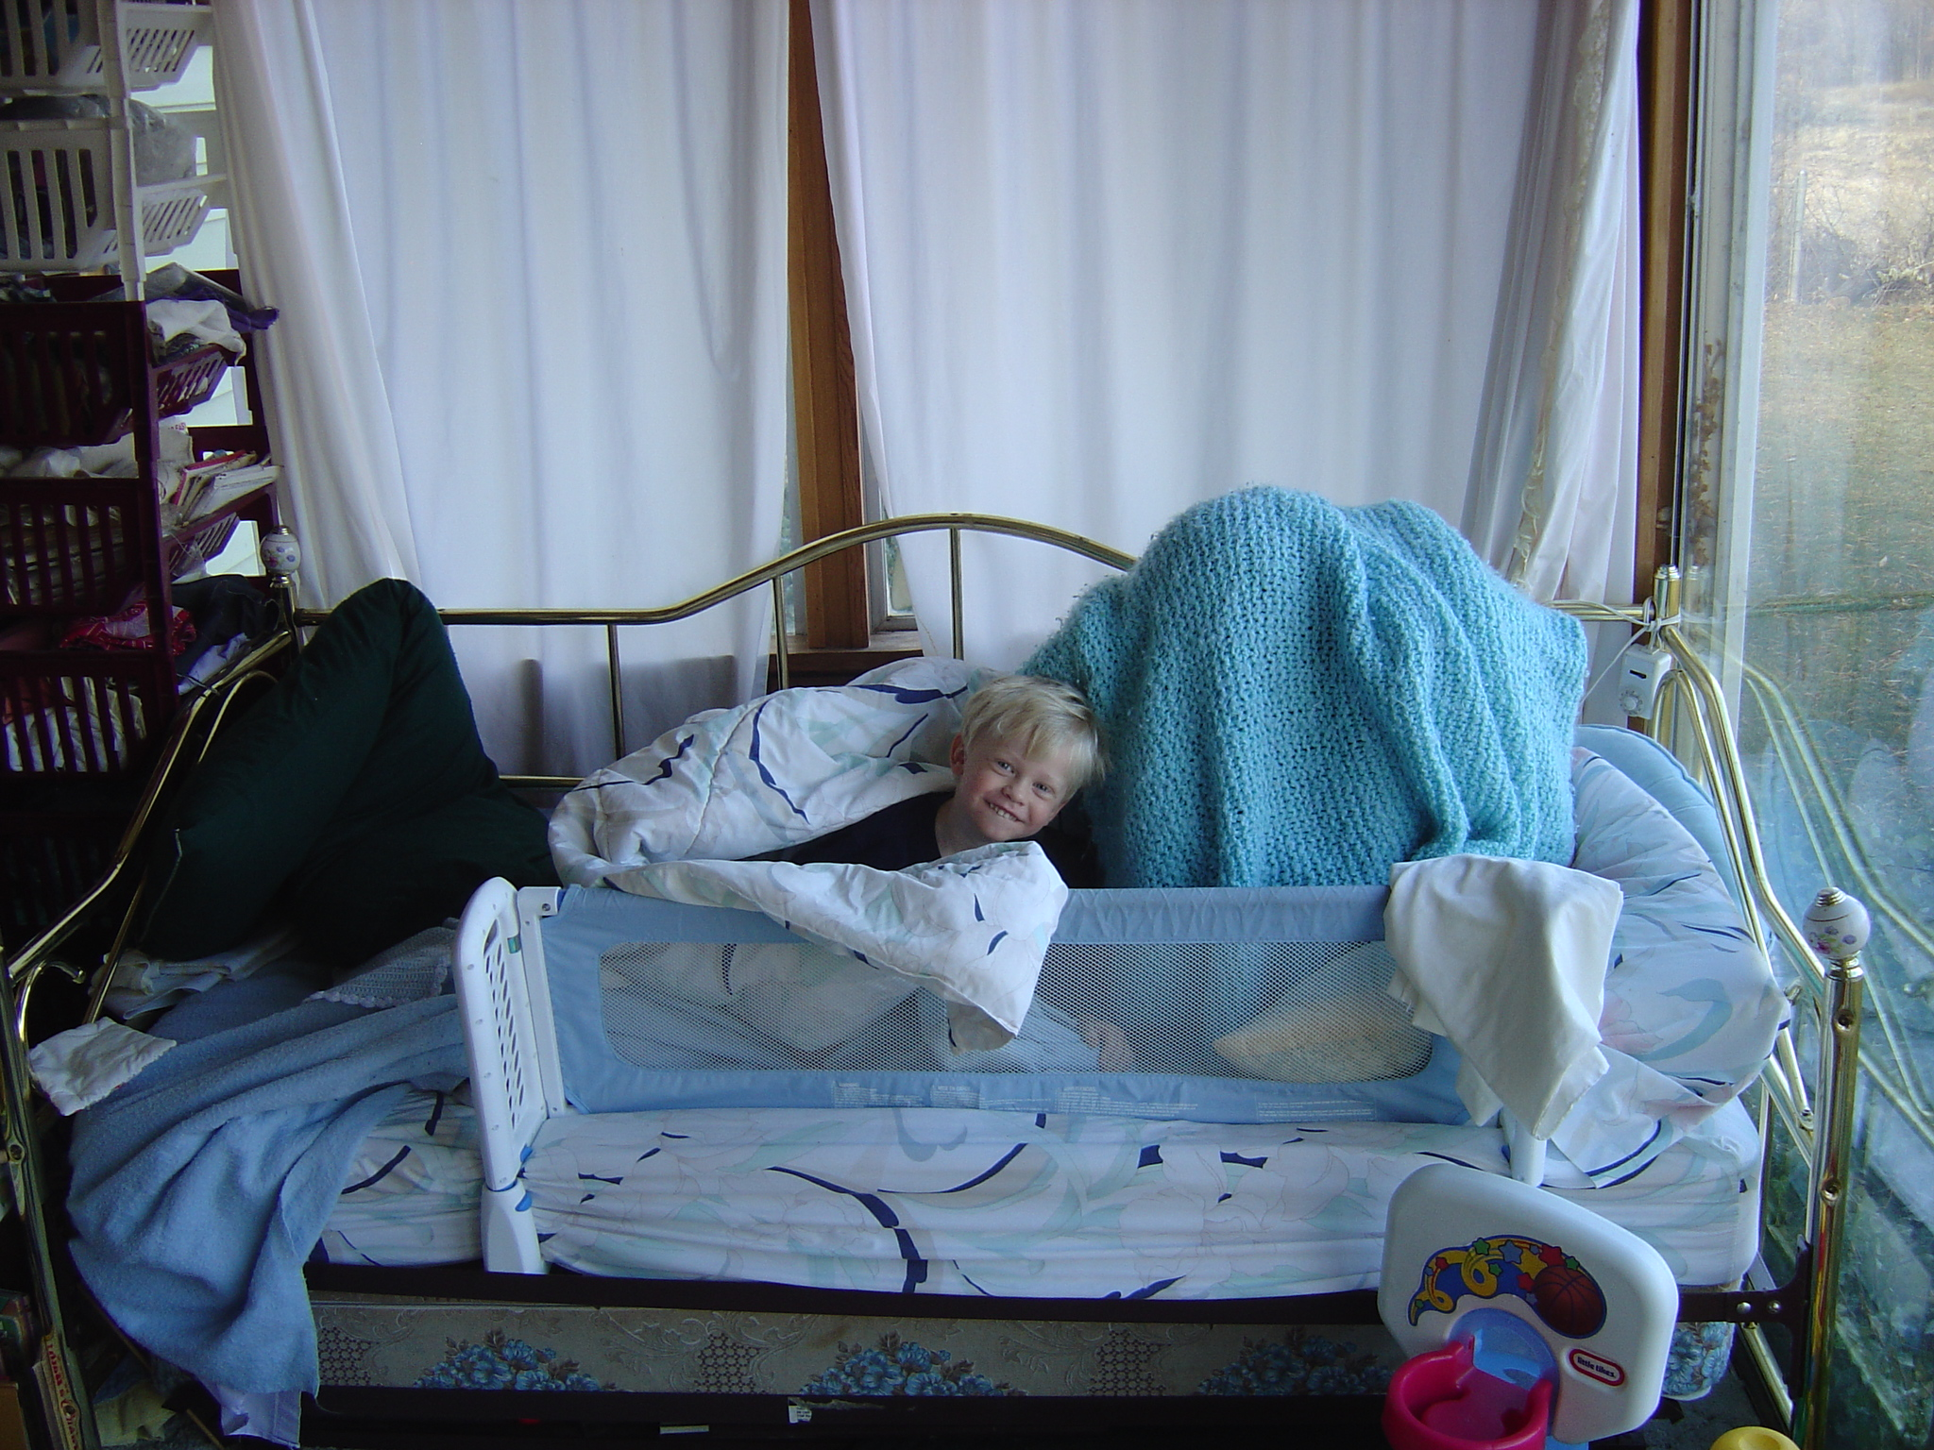
Here I am, Pappa!
Notes:
Why? Because he wants to be found! And I believe the same is true of God. He wants to be found—and He’s sprinkled enough evidence around this world to make it really easy.

Slide 5
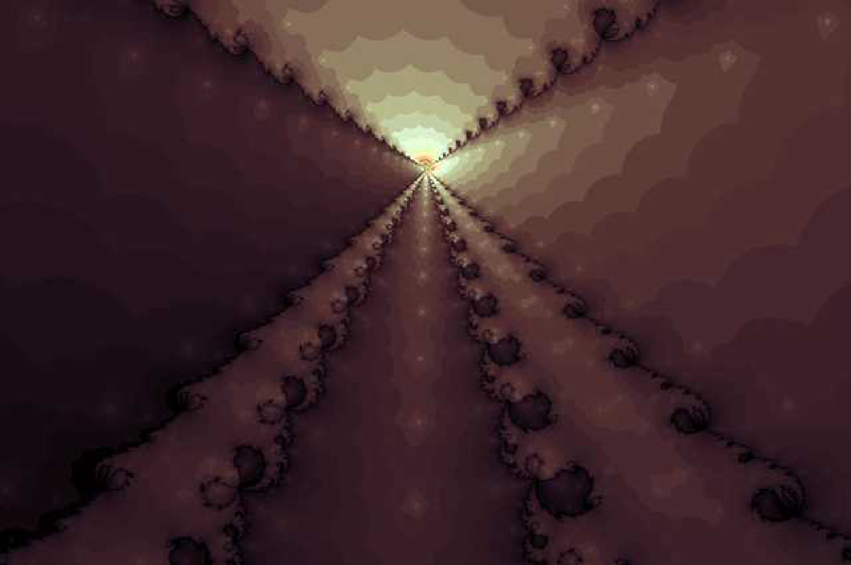
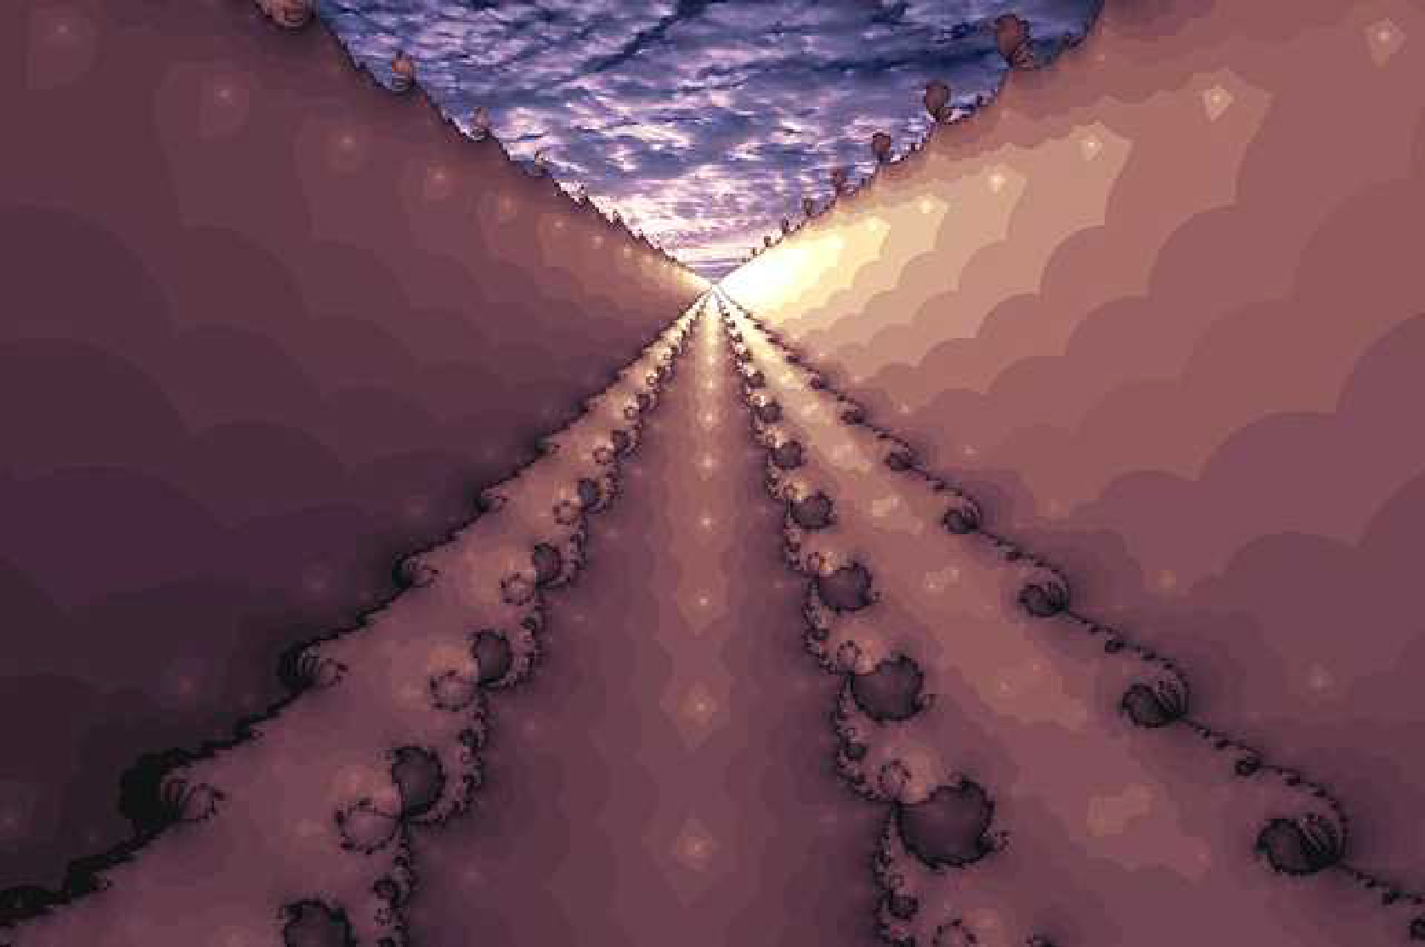
GOD IS NOT HIDING !
GOD
Notes:
In fact, there is so much evidence, it’s almost as if God can’t wait to be found.

Slide 6
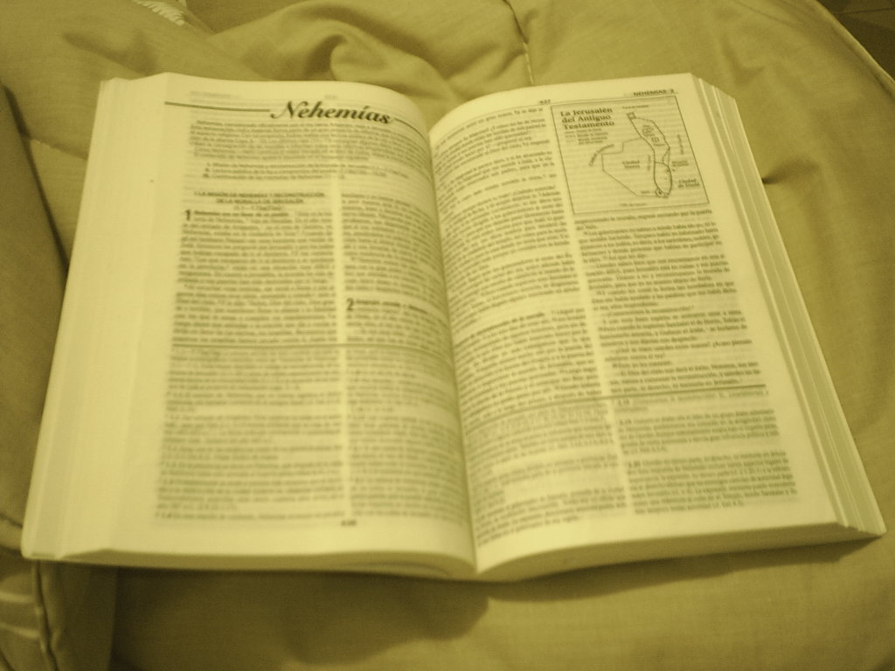
For the invisible things of him from the creation of the world are clearly seen, being understood by the things that are made, even his eternal power and Godhead; so that they are without excuse:
Romans 1:20

Slide 7
Porque las cosas invisibles de l, su eterno poder y deidad, se hacen claramente visibles desde la creacion del mundo, siendo entendedas por medio de las cosas hechas, de modo que no tienen excusa.
Romanos 1:20
For the invisible things of him from the creation
of the world are clearly seen, being understood
by the things that are made, even his eternal power
and Godhead; so that they are without excuse:

Slide 8
… lift up thy voice
with strength;
lift it up, be not afraid;
say unto the cities of Judah,
Behold your God!
Isaiah 40:9

Slide 9

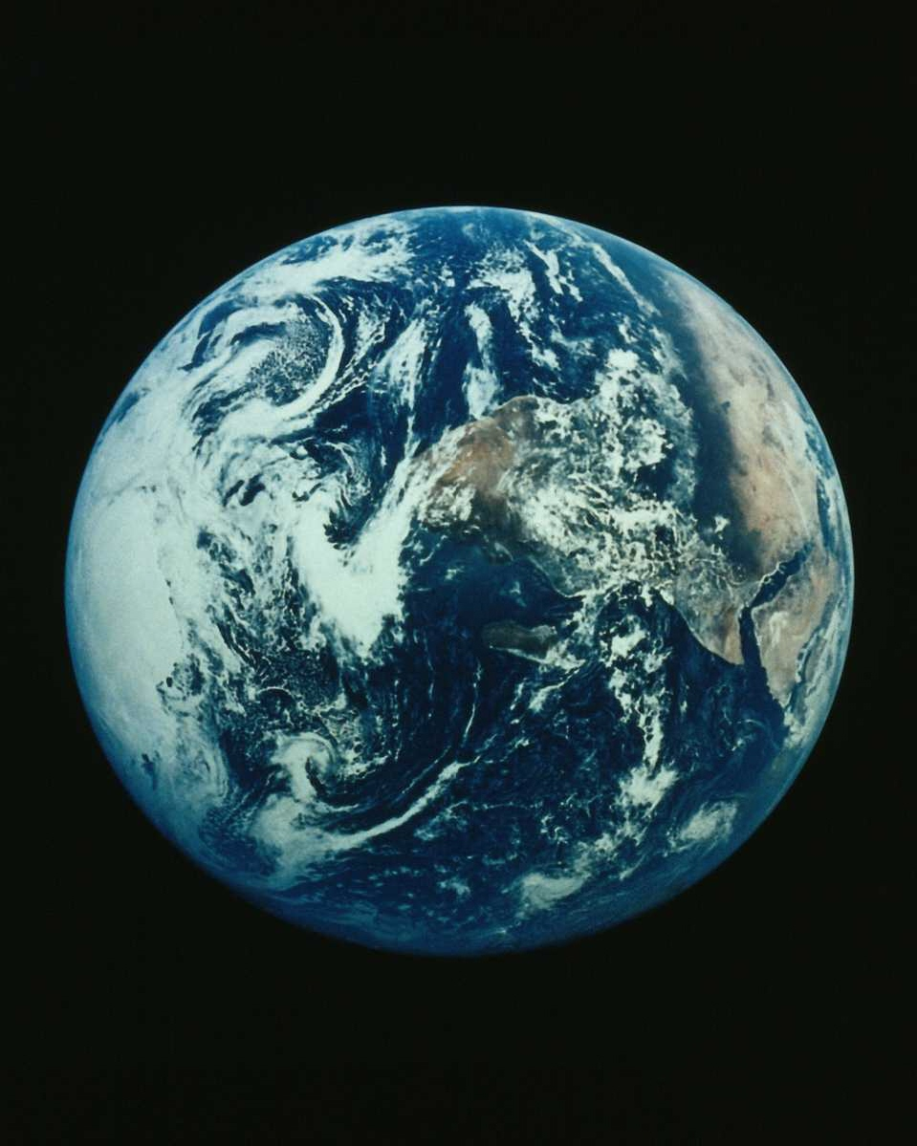
There is enough evidence
in this world for us
to discover
the existence
of God

Slide 10
… levántala, no temas;
Dí a las ciudades de Judá:
¡Ved aquí al
Dios vuestro!
Isaías 40:9
… lift up thy voice with strength; lift it up,
be not afraid; say unto the cities of Judah,
Behold your God!

Slide 11
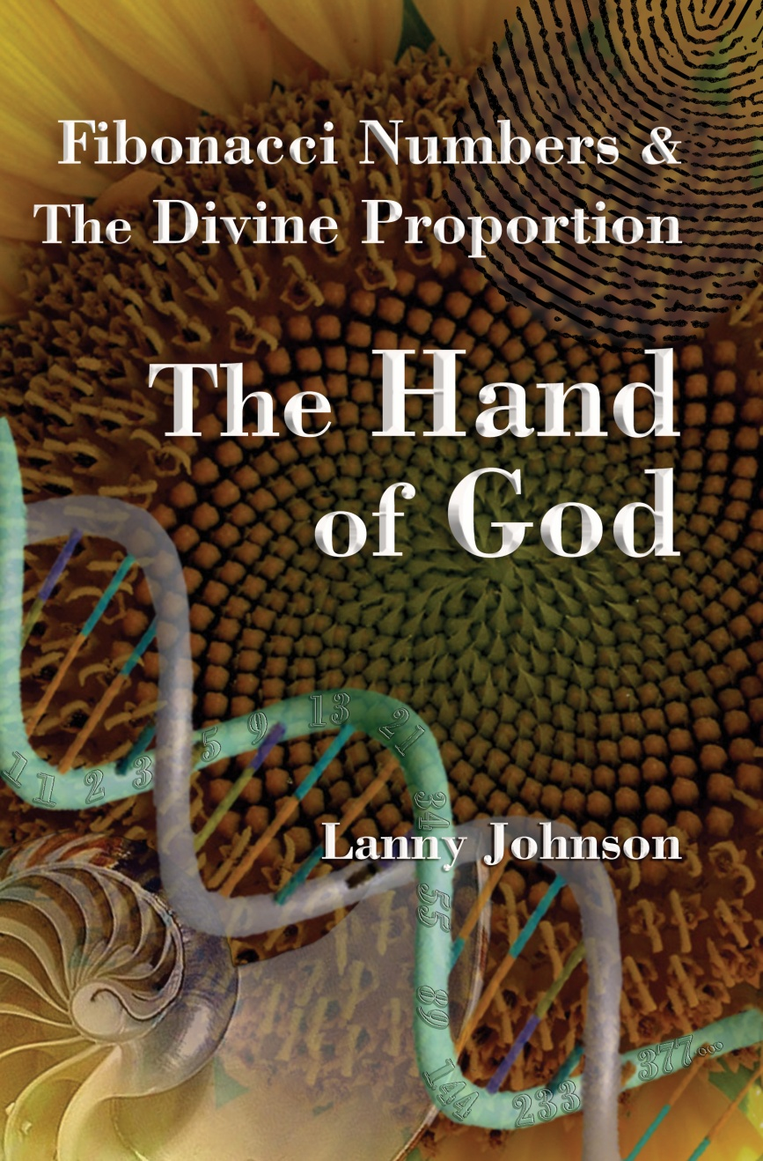
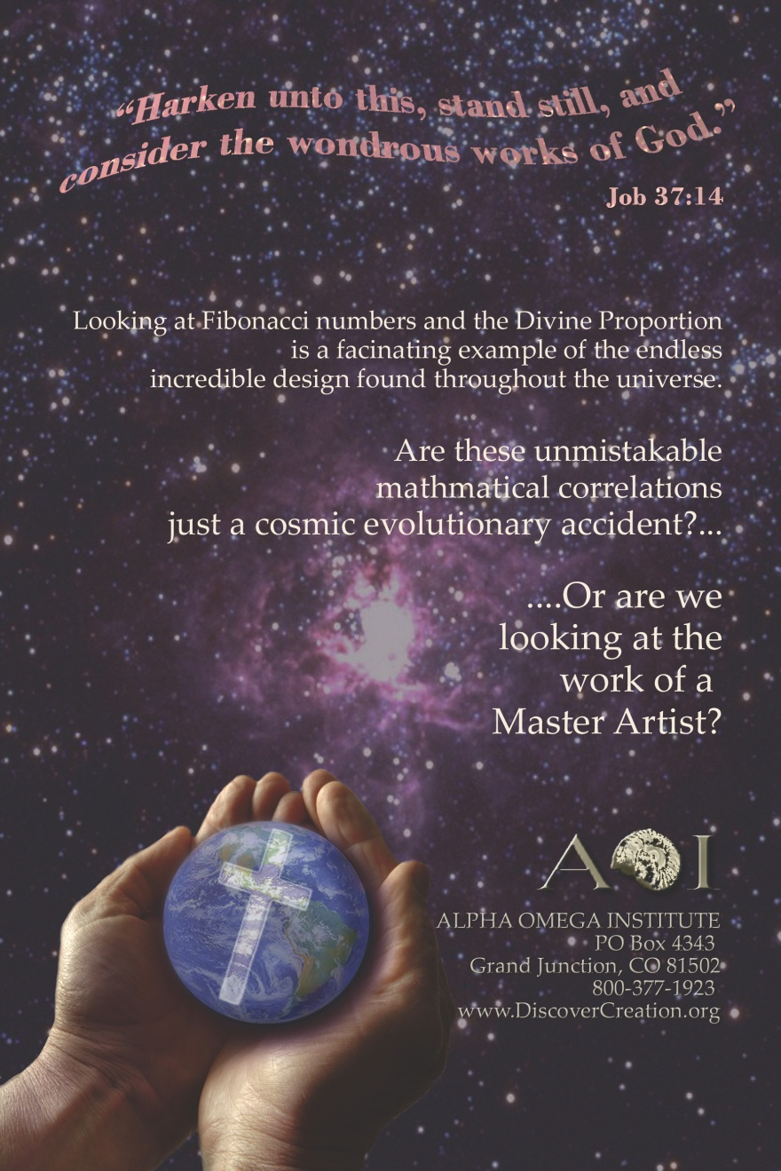

Slide 12
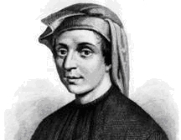
mathematician
LEONARDO
FIBONACCI
(later known as
LEONARDO
PISANO)
At beginning of 13th century
was asked by a member of the
royal family:

Slide 13

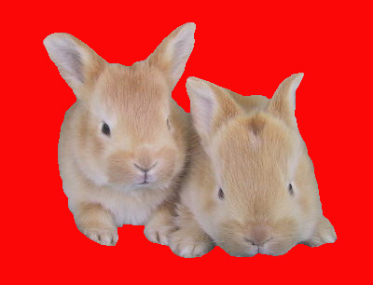
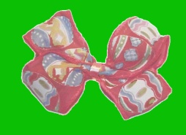
Let’s suppose a man puts two newborn baby rabbits, one male and one female, into a large enclosure. If these particular kinds of rabbit can only have babies when they reach the age of two months, and the babies are always a single pair, one male and one female, how many rabbits will be in the enclosure in one year’s time?

Slide 14
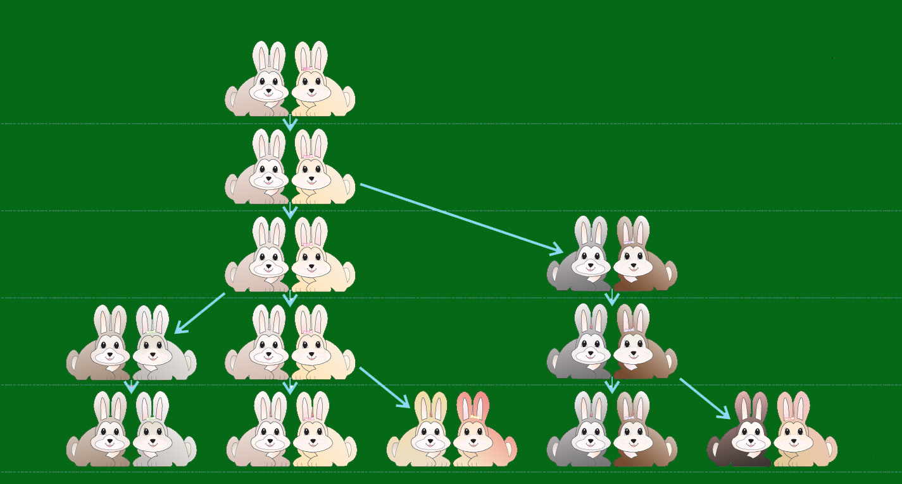
Months
Pairs of
Rabbits
1
1
2
1
3
2
4
3
5
5
Notes:
At the end of the 1st month, the rabbits breed, but there is still on 1 pair of rabbits. At the end of the 2nd month the female delivers a pair, so now there are 2 pairs of rabbits. Athe the end of the 3rd month, the original female delivers a 2nd pair, making 3 pairs in all. At the end of the fourth month, the original female has delivered yet another new pair, and the female born 2 months ago delivers her first pair, making 5 pairs of rabbits.

Slide 15
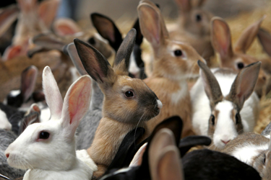
FIBONACCI NUMBERS
(Fibonacci Sequence)
0, 1, 1, 2, 3, 5, 8, 13, 21, 34, 55…

Slide 16
0+1= 1
13+21 = 34
1+1= 2
21+34 = 55
1+2 = 3
34+55 = 89
2+3 = 5
55+89 = 144
3+5 = 8
89+144 = 233
5+8 = 13
144+233 = 377
8+13 = 21
ETC.

Slide 17


Notes:
Well, you’re asking, so what? What does that have to do with God? More than you might think. As it turns out, Leonardo stumbled across a very important mathematical principle, known as he Fibonacci sequence, or Fibonacci numbers. And even though it was first used to count rabbits, it just might be one of the blueprints used to create the universe.

Slide 18
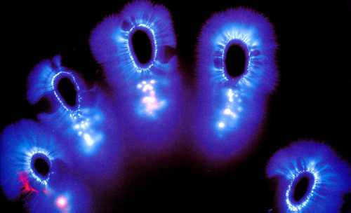
I believe that
Fibonacci numbers
are a
FINGERPRINT
OF GOD

Slide 19
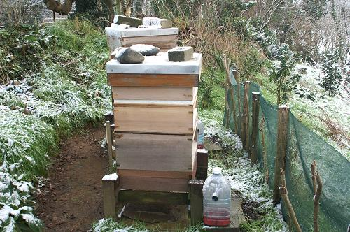


8 Great-great-great grandparents
3 Great-grandparents
1 Parent
(Female)
Male Bee
2 Grandparents
5 Great-great grandparents
13 great-great-great-great grandparents

Slide 20
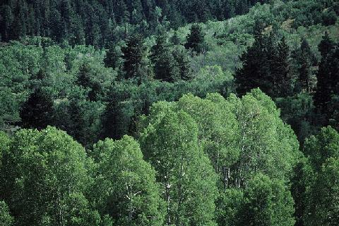
PHYLLOTAXIS
Arrangement of leaves and branches around the stem of a plant

Slide 21

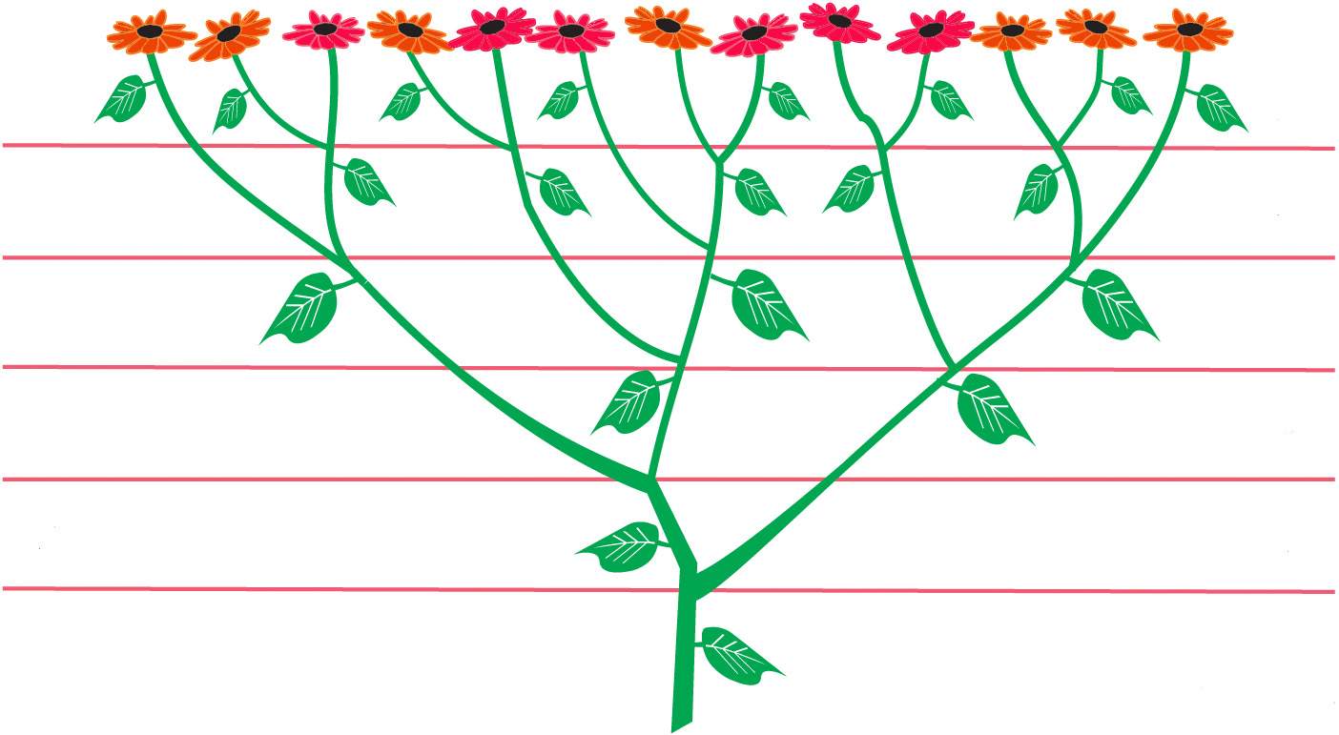
Fibonacci numbers are found in the arrangement of leaves and branches in many plants
13
8
8
5
5
3
3
2
2
1
1
1
Branches
Leaves

Slide 22
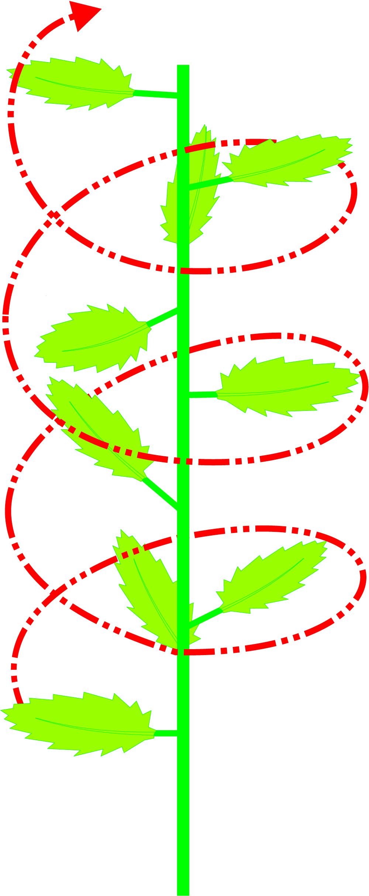
8
6
PHYLLOTAXIS
7
King Sugarbush
5
4
3
Every eighth leaf
occupies the same
vertical position on
the stem after
exactly 3 turns
1
2
0

Slide 23
Phyllotaxis of different Plants
T is number of turns on stem. L is number of leaves within turn(s) [shown as fraction T / L]
Basswood, Elm, & many bulbous plants
1 / 2
Hazel, Beech, Sedge, Alder, & Birch
1 / 3
Apricot, Cherry, Willow, Oak, Rose, &
Stone-fruit
2 / 5
Pear, Poplar, Cabbage, Aster, &
Hawkweed
3 / 8
Almond & Pussy Willow
5 / 13
Spruce & Fir Cones
8 / 21
Some Pines
13 / 34

Slide 24
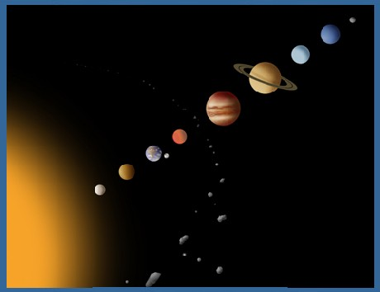
Neptune
Uranus 1 / 2
Saturn 1 / 3
Jupiter 2 / 5
Asteroids 3 / 8
Mars 5 / 13
Earth 8 / 13
8 / 21
Venus 13 / 21
Mercury 13 / 34
Revolution of the planets in days compared in round numbers to the planet next to it

Slide 25
Anthropic Principle – the universe seems to be
carefully designed for the well-being of people
The earth’s distance from the sun is just right.
The earth’s distance from the moon is just right
The earth is the only planet in the universe
known to have liquid water (About 72% of earth
surface is covered by water)
The earth’s atmosphere is just right (nitrogen – 78%, oxygen – 21% + water vapor and other gases needed for life)
The earth’s gravity seems to be just right
The earth’s magnetic field protects us from
harmful radiation.

Slide 26
Neptune
“The heavens declare his
righteousness, and all the
people see his glory.”
Ps. 97:6
Uranus 1 / 2
Saturn 1 / 3
Jupiter 2 / 5
Asteroids 3 / 8
Mars 5 / 13
Earth 8 / 13
8 / 21
Venus 13 / 21
Mercury 13 / 34
“For thus saith the LORD that created the heavens; God himself that
formed the earth and made it; he hath established it, he created it not
in vain, he formed it to be inhabited: I am the LORD; and there is
none else.” Isa 45:18
Notes:
Ps 97:6 The heavens declare his righteousness, and all the people see his glory.
Isa 45:18 For thus saith the LORD that created the heavens; God himself that formed the earth and made it; he hath established it, he created it not in vain, he formed it to be inhabited: I am the LORD; and there is none else.

Slide 27

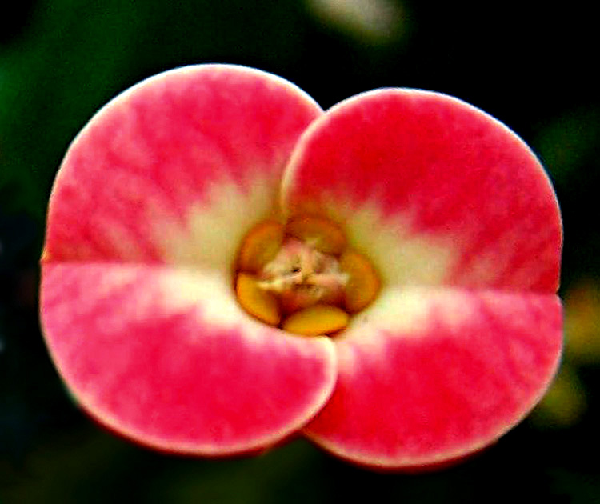
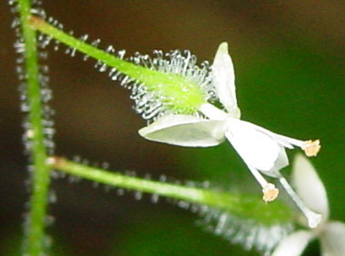
Euphorbia
2
Enchanter's
Nightshade

Slide 28
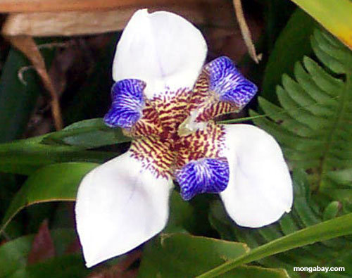
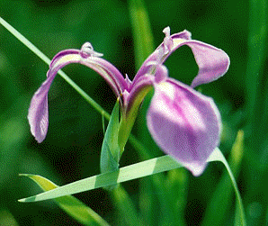
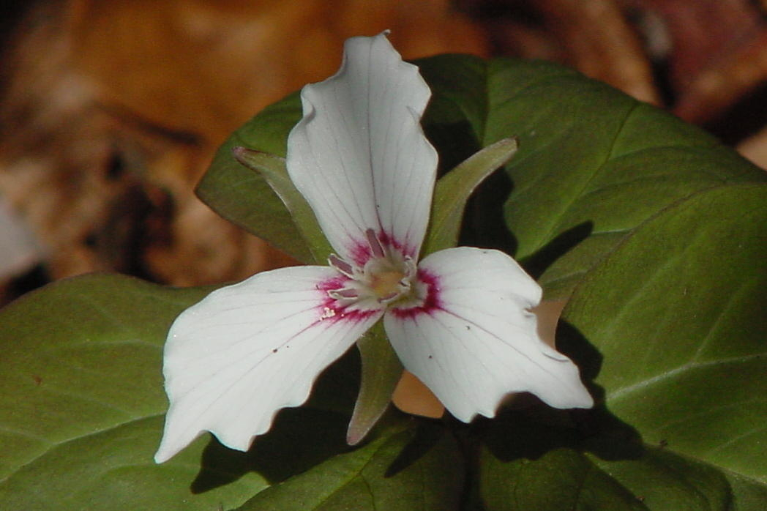
Lily
Iris
3
Trilium

Slide 29
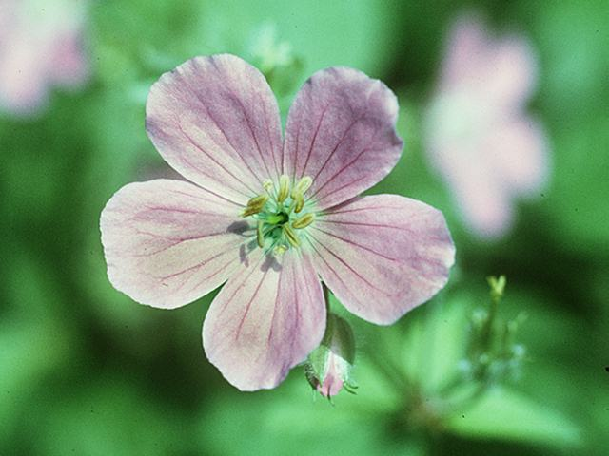
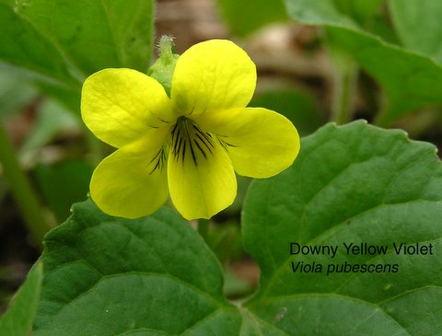
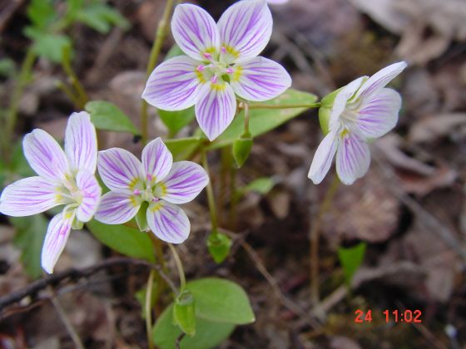
5
Yellow Violet
Wild Geranium
Spring Beauty

Slide 30
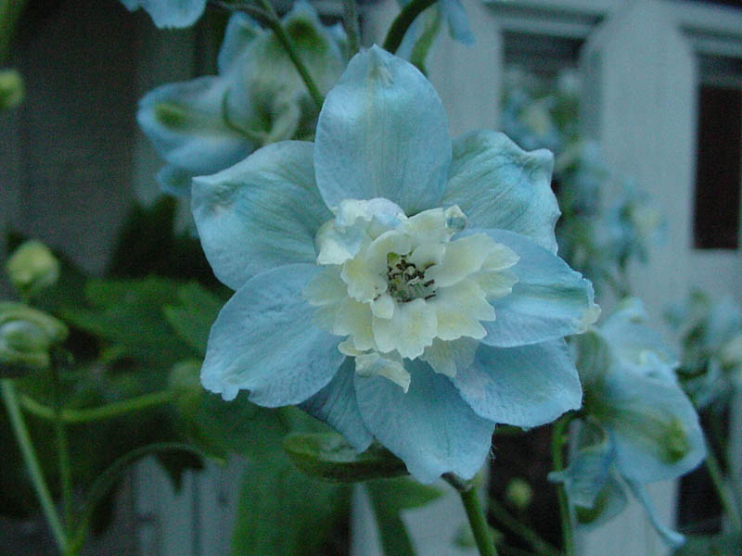
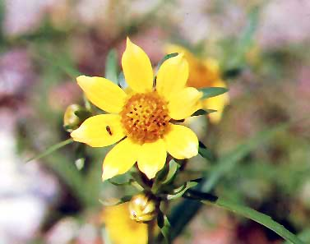
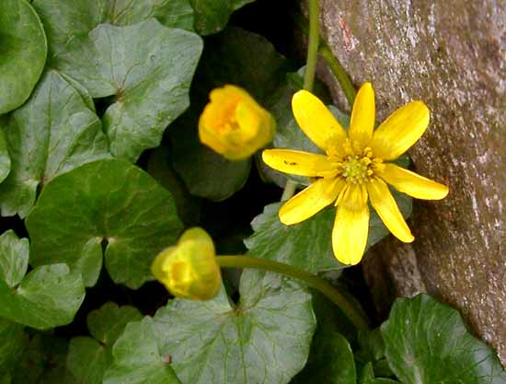
Delphinium
8
Sticktight
Lesser Celandine

Slide 31
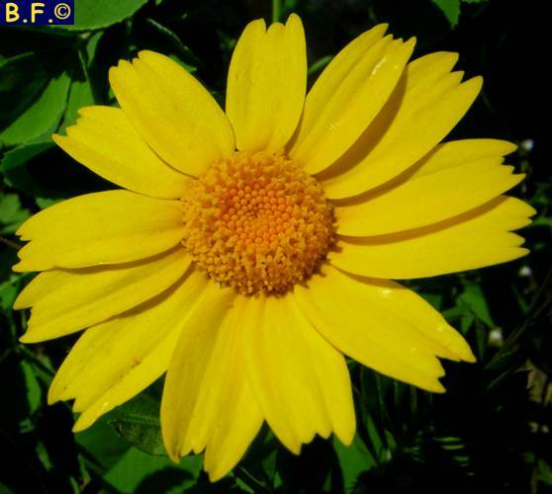
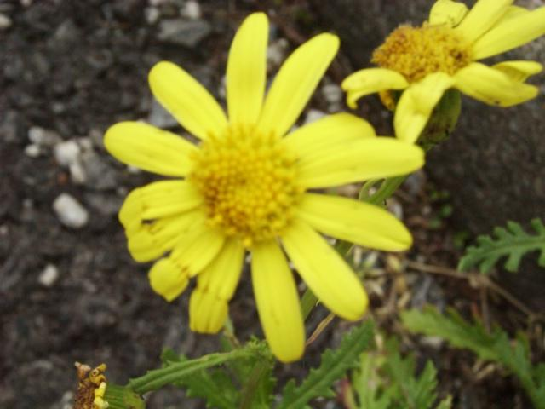
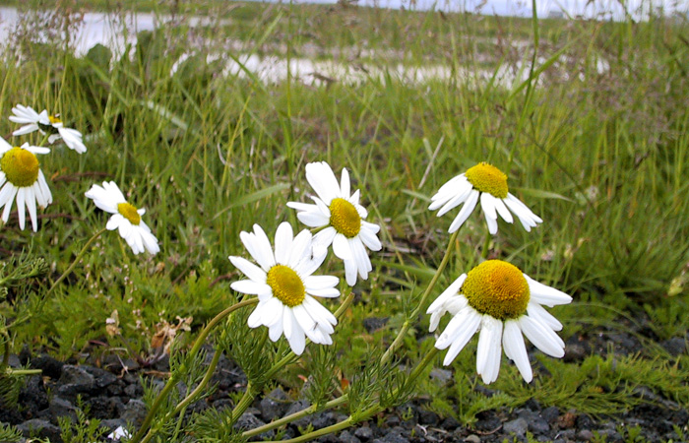
13
Corn Marigold
Ragwort
Mayweed

Slide 32
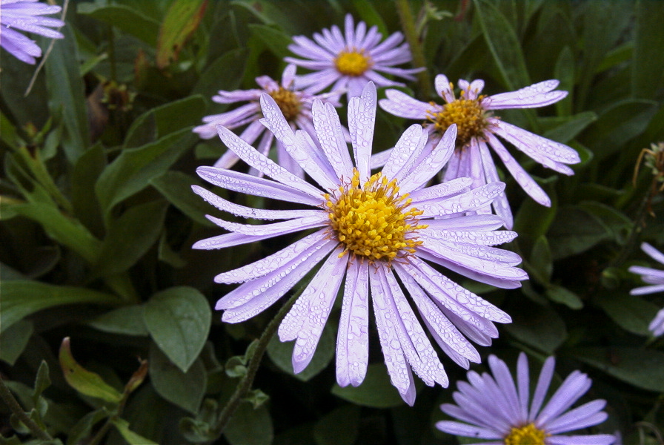
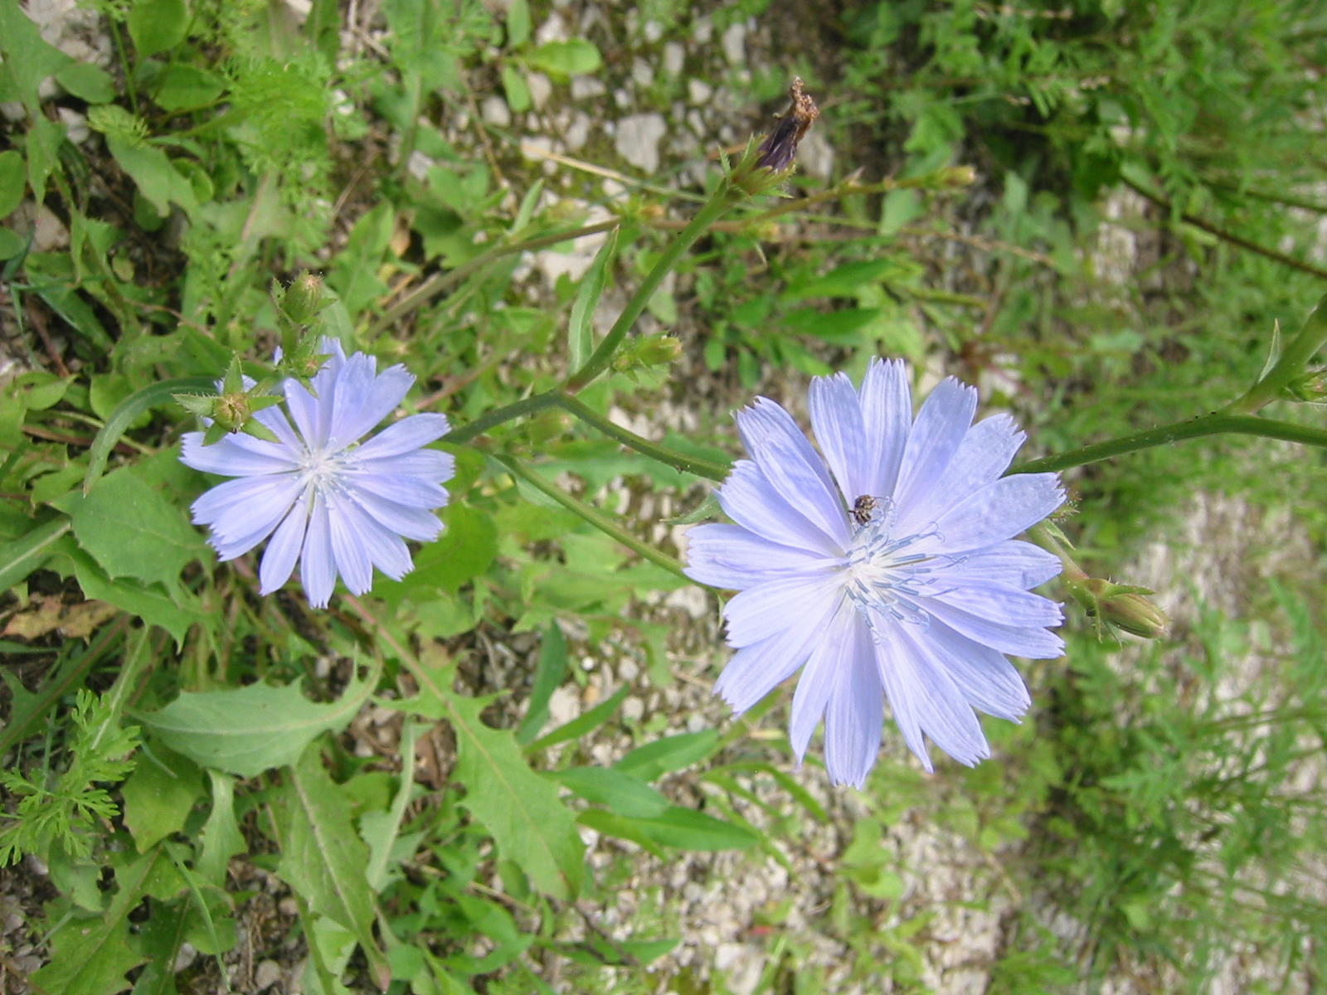
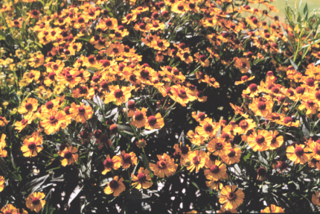
Aster
21
Chicory
Helenium

Slide 33
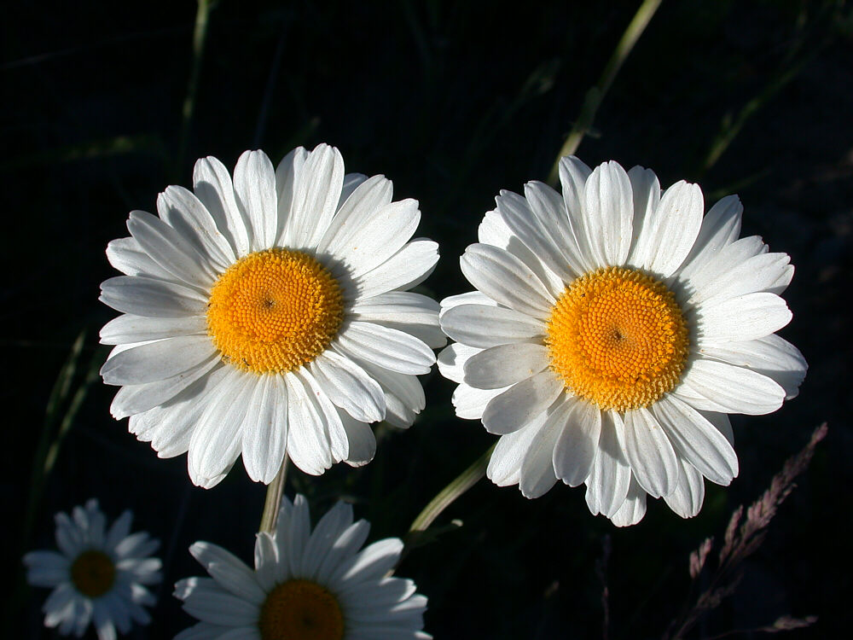
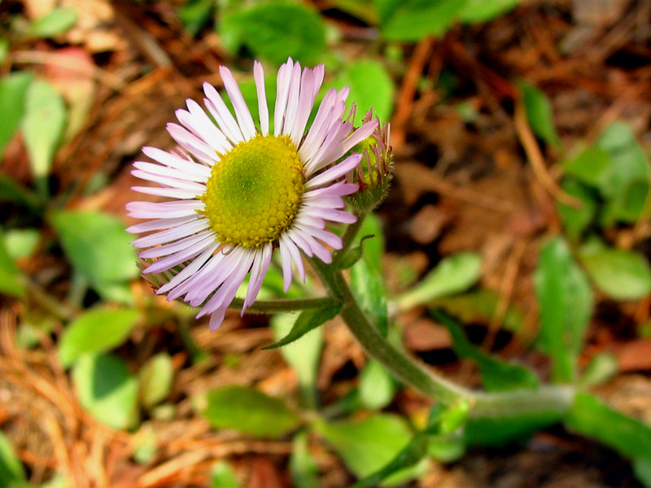
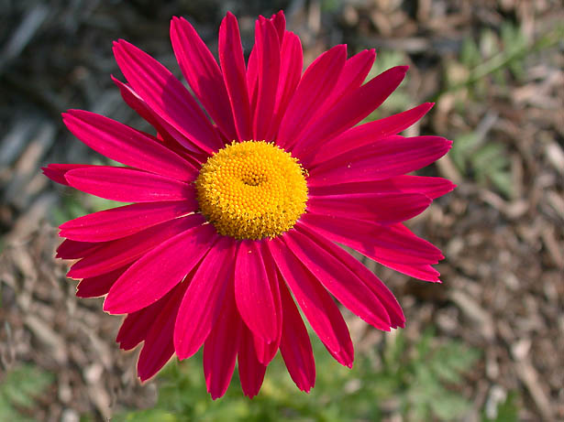
Robin’s Plantain
34
Ox-eye Daisy
Pyrethrum

Slide 34
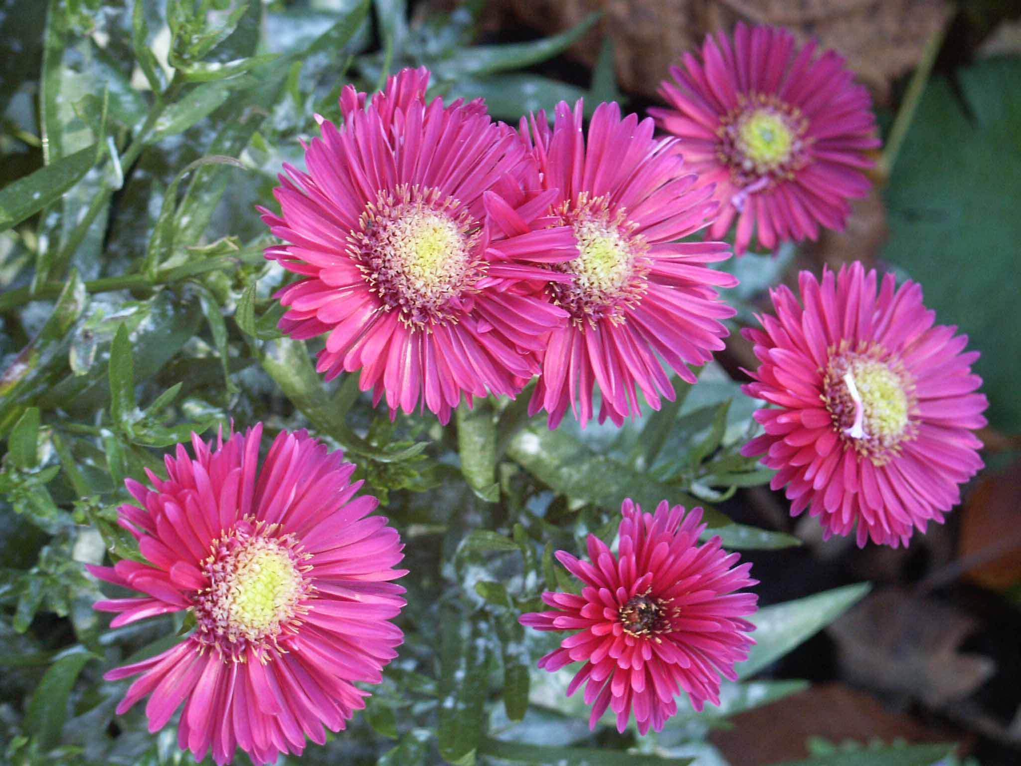
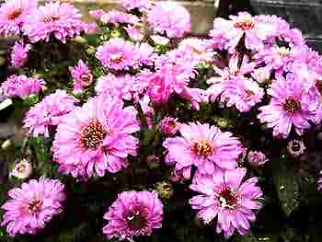
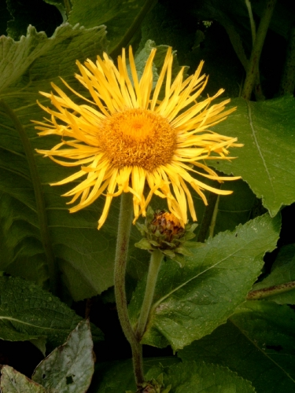
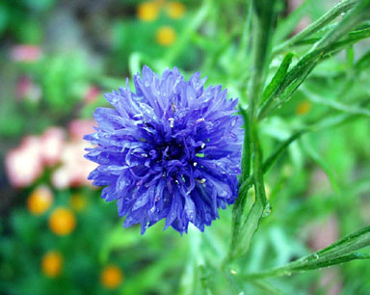
Michaelmas
55
Helenium
Field Daisy

Slide 35
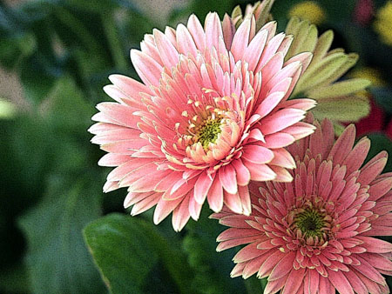
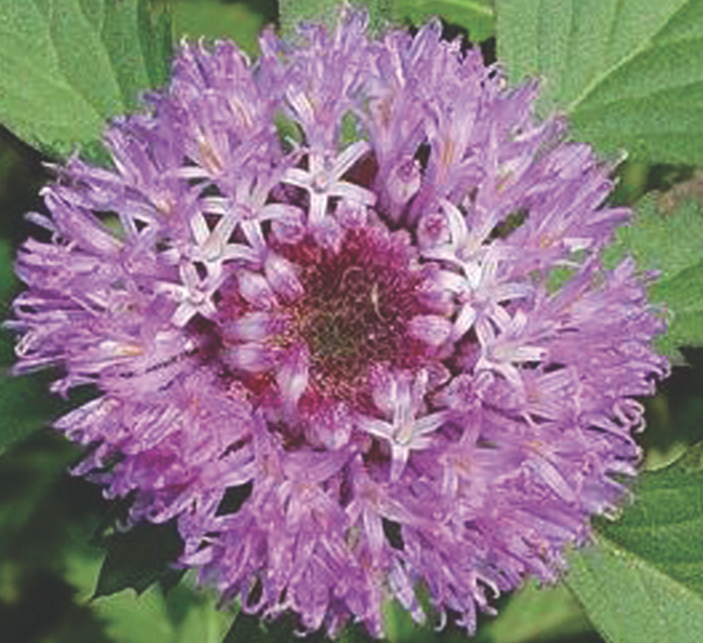
Gerber Daisy
89
Michaelmas

Slide 36

The ratio of any Fibonacci to the
one before it is roughly 1.618034
2/1 = 2.0
34/21 = 1.6190
3/2 = 1.5
55/34 = 1.6176
5/3 = 1.67
89/55 = 1.6181
8/5 = 1.6
144/89 = 1.6179
13/8 = 1.625
233/144 = 1.6180
21/13 = 1.6153
377/233 = 1.6180

Slide 37
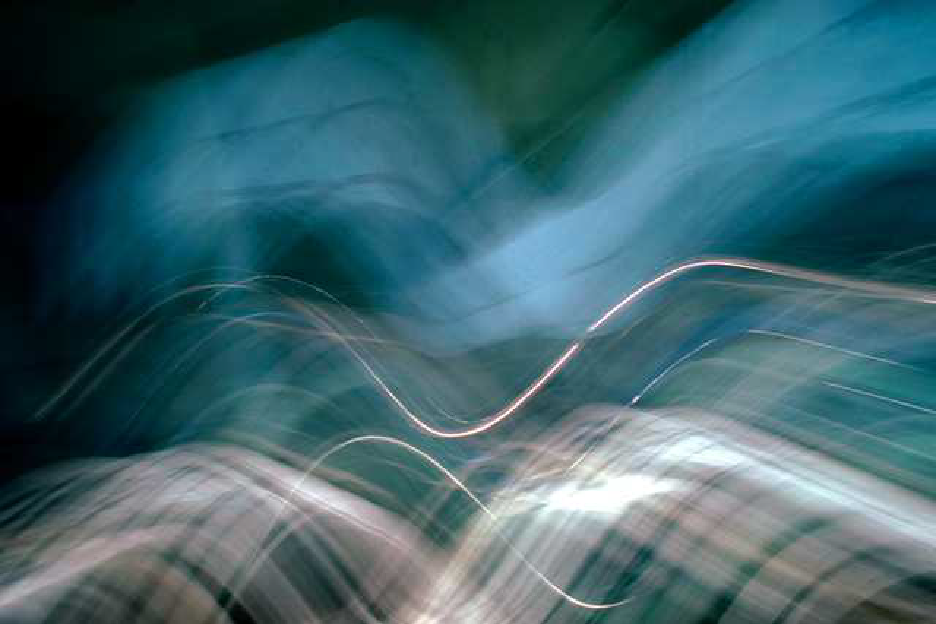
1.618
This number is so
special, that is
called the …
Golden Ratio
Divine Proportion

Slide 38
1
.618
1.618

Slide 39
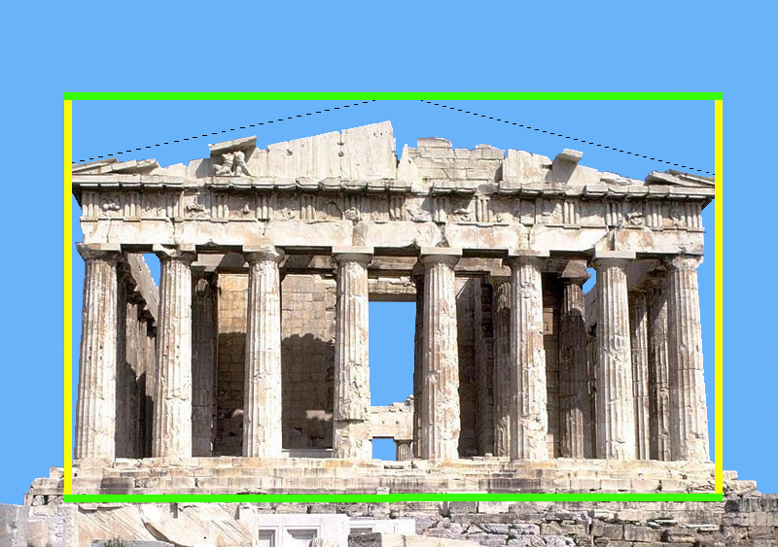
PARTHENON
1.618 TIMES AS WIDE AS HIGH

Slide 40
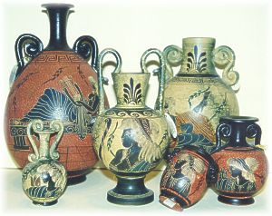
GREEK POTTERY
WHY?
The ‘GOLDEN RATIO’ was more pleasing
to the eye than any other ratio

Slide 41
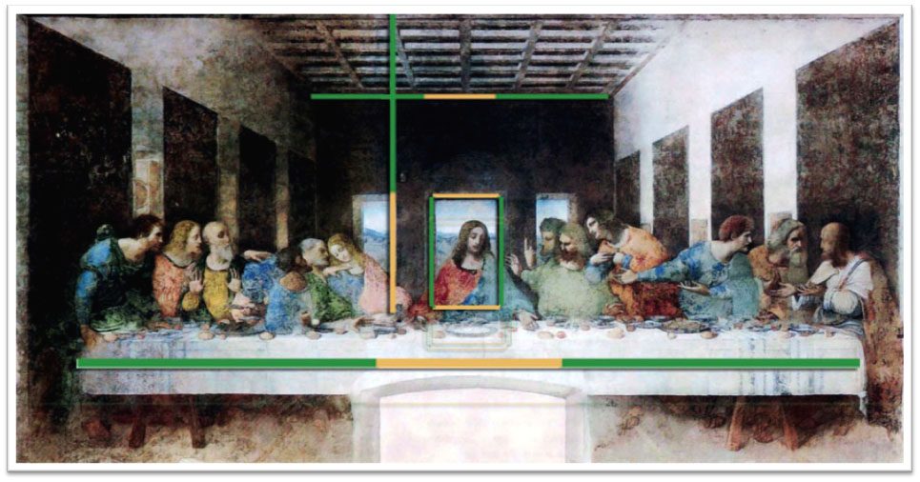
LAST SUPPER
By
Leonardo da Vinci

Slide 42


Mozart …Beethoven … Bach
SOME OF THE
CLASSIC MUSIC
WE FIND BEAUTIFUL
HAS THE FIRST
MOVEMENT 1.618 TIMES AS LONG AS THE SECOND MOVEMENT
Notes:
And it’s been noticed by some students of music that the stuff we find really beautiful has the same golden ratio—where the first movement is 1.618 times as long as the second one,

Slide 43

COULD IT BE THAT
THE GOLDEN RATIO
IS ONE OF THE BLUEPRINTS
GOD USED AT CREATION?

Slide 44

Your forearm is roughly
1.618 times as long as
your hand

Slide 45

Each segment in your
finger is roughly
1.618 times
as long as
the next
one

Slide 46

Mona Lisa
By
Leonardo da Vinci
Face is 1.618
long as it is wide

Slide 47

On the average, our mouths are
1.618 times as wide as our nose

Slide 48

On the average, our pupils are
1.618 times as wide as our mouth

Slide 49

PLASTIC
SURGERY
The “Golden Ratio”
happens so often that
some plastic surgeons
have begun using this
number to improve
people’s looks

Slide 50
DNA
21 angstroms wide
and 34 angstroms
long in one full turn of its spiral

Slide 51
DNA

Slide 52
Ratio of AB to BC
= 1.618
Pentagram
B
A
C

Slide 53

Hibiscus
Wild Geranium
Spring Beauty
Wood Sorrel
Yellow Violet
Plumeria
Saxifrage
Wild Rose
Pipsissewas
Bellflower
Filaree
Hoya plant
Columbine
Cinquefoil
Chickweed
Passion flower

Slide 54


Apple core

Slide 55

Starfish

Slide 56

Sand dollar

Slide 57





1
1.618
1
1
1
1
1
1
Golden Spiral

Slide 58

MOST SPIRALS
FOUND IN NATURE ARE
GOLDEN SPIRALS

Slide 59


Nautilus

Slide 60

Snails

Slide 61

Ram’s Horns

Slide 62
Kudu

Slide 63

the tails of seahorses,
Seahorse Tail

Slide 64

Fangs

Slide 65

Teeth

Slide 66

Beaver Teeth

Slide 67

Elephant Tusks

Slide 68

Mammoth Tusks

Slide 69

Wart Hog

Slide 70

Wild Boar

Slide 71


Bear Claws

Slide 72

Cat Claws

Slide 73

Talons

Slide 74

Beaks

Slide 75

Some Spider Webs

Slide 76

Umbilical Cord

Slide 77

Cochlea of the Human Ear

Slide 78
DNA

Slide 79

Hurricanes

Slide 80

whirlpools in the ocean,
Whirlpools

Slide 81

Ocean Waves

Slide 82

Spiral Galaxies

Slide 83

and the tail of a comet as it winds around the sun.
Orbit of a Comet

Slide 84

Tornadoes

Slide 85

Sunflower

Slide 86

34 Spirals to Left

Slide 87

55 Spirals to Right

Slide 88


Pinecone

Slide 89

13 Spirals to Left

Slide 90

8 Spiral to Right

Slide 91

Pinecone

Slide 92

Bracts

Slide 93

8 Spirals
to Left

Slide 94

5 Spirals to Right

Slide 95

Cauliflower

Slide 96


Slide 97

Romanesque

Slide 98


Slide 99


Slide 100


Slide 101


_{GOLDEN ANGLE}
222.5°
4
6
1
2
3
5
AONIUM

Slide 102

222.5
÷ 137.5
1.618

Slide 103

It is obvious that
Somebody
made this world
It just can’t be
an accident!

Slide 104
God
cares about
the details

Slide 105
For Information and
Seminars contact:
Alpha Omega Institute
P.O. Box 4343
Grand Junction, CO
81502
(970) 523-9943
www.discovercreation.org

Slide 106
He telleth the number of the stars; he calleth them all by their names.
Psalm 147:4

Slide 107

Today scientists estimate there are more than 10**25 stars (about the same order of magnitude as the number of grains of sand on the earth)
Today, scientists estimate there
are 125 billion galaxies in the
universe, and each galaxy contains
hundreds of millions of stars …
as many stars in the universe as the grains of all the sand on the beaches of the world.

Slide 108
Today scientists estimate there are more than 10**25 stars (about the same order of magnitude as the number of grains of sand on the earth)
The Bible said that the stars cannot be numbered
3000 years before
astronomers figured it out …

Slide 109
As the host of heaven cannot be numbered, neither the sand of the sea measured: …
Jeremiah 33:22
See also Genesis 15:5, Genesis 22:17

Slide 110
El cuenta el número
del las estrellas;
A todas ellas llama por
sus nombres
Salmos 147:4
He telleth the number of the stars; he calleth them all by their names.

Slide 111
God
cares about
you

Slide 112
But even the very hairs of your head are all numbered. Fear not therefore: ye are of more value than many sparrows.
Luke 12: 7

Slide 113
Pues aun los cabellos
de vuestra cabeza están todos
contados. No temáis, pues;
más valéis vosotros que
muchos pajarillos.
S. Lucas 12: 7
But even ye are of more value than many sparrows.the very hairs of your head are all numbered. Fear not therefore:

Slide 114


Slide 115


In several New Testament passages, we find evidence that Christ was the Creator! John 1:1-3 records, “In the beginning was the Word, and the Word was with God, and the Word was God. The same was in the beginning with God. All things were made through him; and without him was not anything made that hath been made” (emp. added).
For by grace are ye saved through faith; and that not of yourselves:
it is the gift of God:
Not of works, lest any man should boast. For we are his workmanship,
created in Christ Jesus unto good works, which God hath before ordained that we should walk in them. Ephesians 2:8-10

Slide 116
For God so loved the world, that he gave his only begotten Son, that whosoever believeth in him should not perish, but have everlasting life.
John 3:16

Slide 117
… lift up thy voice
with strength;
lift it up, be not afraid;
say unto the cities of Judah,
Behold your God!
Isaiah 40:9

Slide 118
For Information and
Seminars contact:
Alpha Omega Institute
P.O. Box 4343
Grand Junction, CO
81502
(970) 523-9943
www.discovercreation.org

Slide 119
Alpha Omega Institute
www.discovercreation.org
If you have enjoyed this program there
are 2 ways you can Help us
to continue spreading the truth
of Creation and Salvation:
Prayer
Financial Support

