Slide 1


DISCOVER
CREATION
LANNY & MARILYN JOHNSON
ALPHA OMEGA INSTITUTE
P.O. Box 4343 • Grand Junction, CO • 81502
(970) 523-9943 • www.discovercreation.org

Slide 2
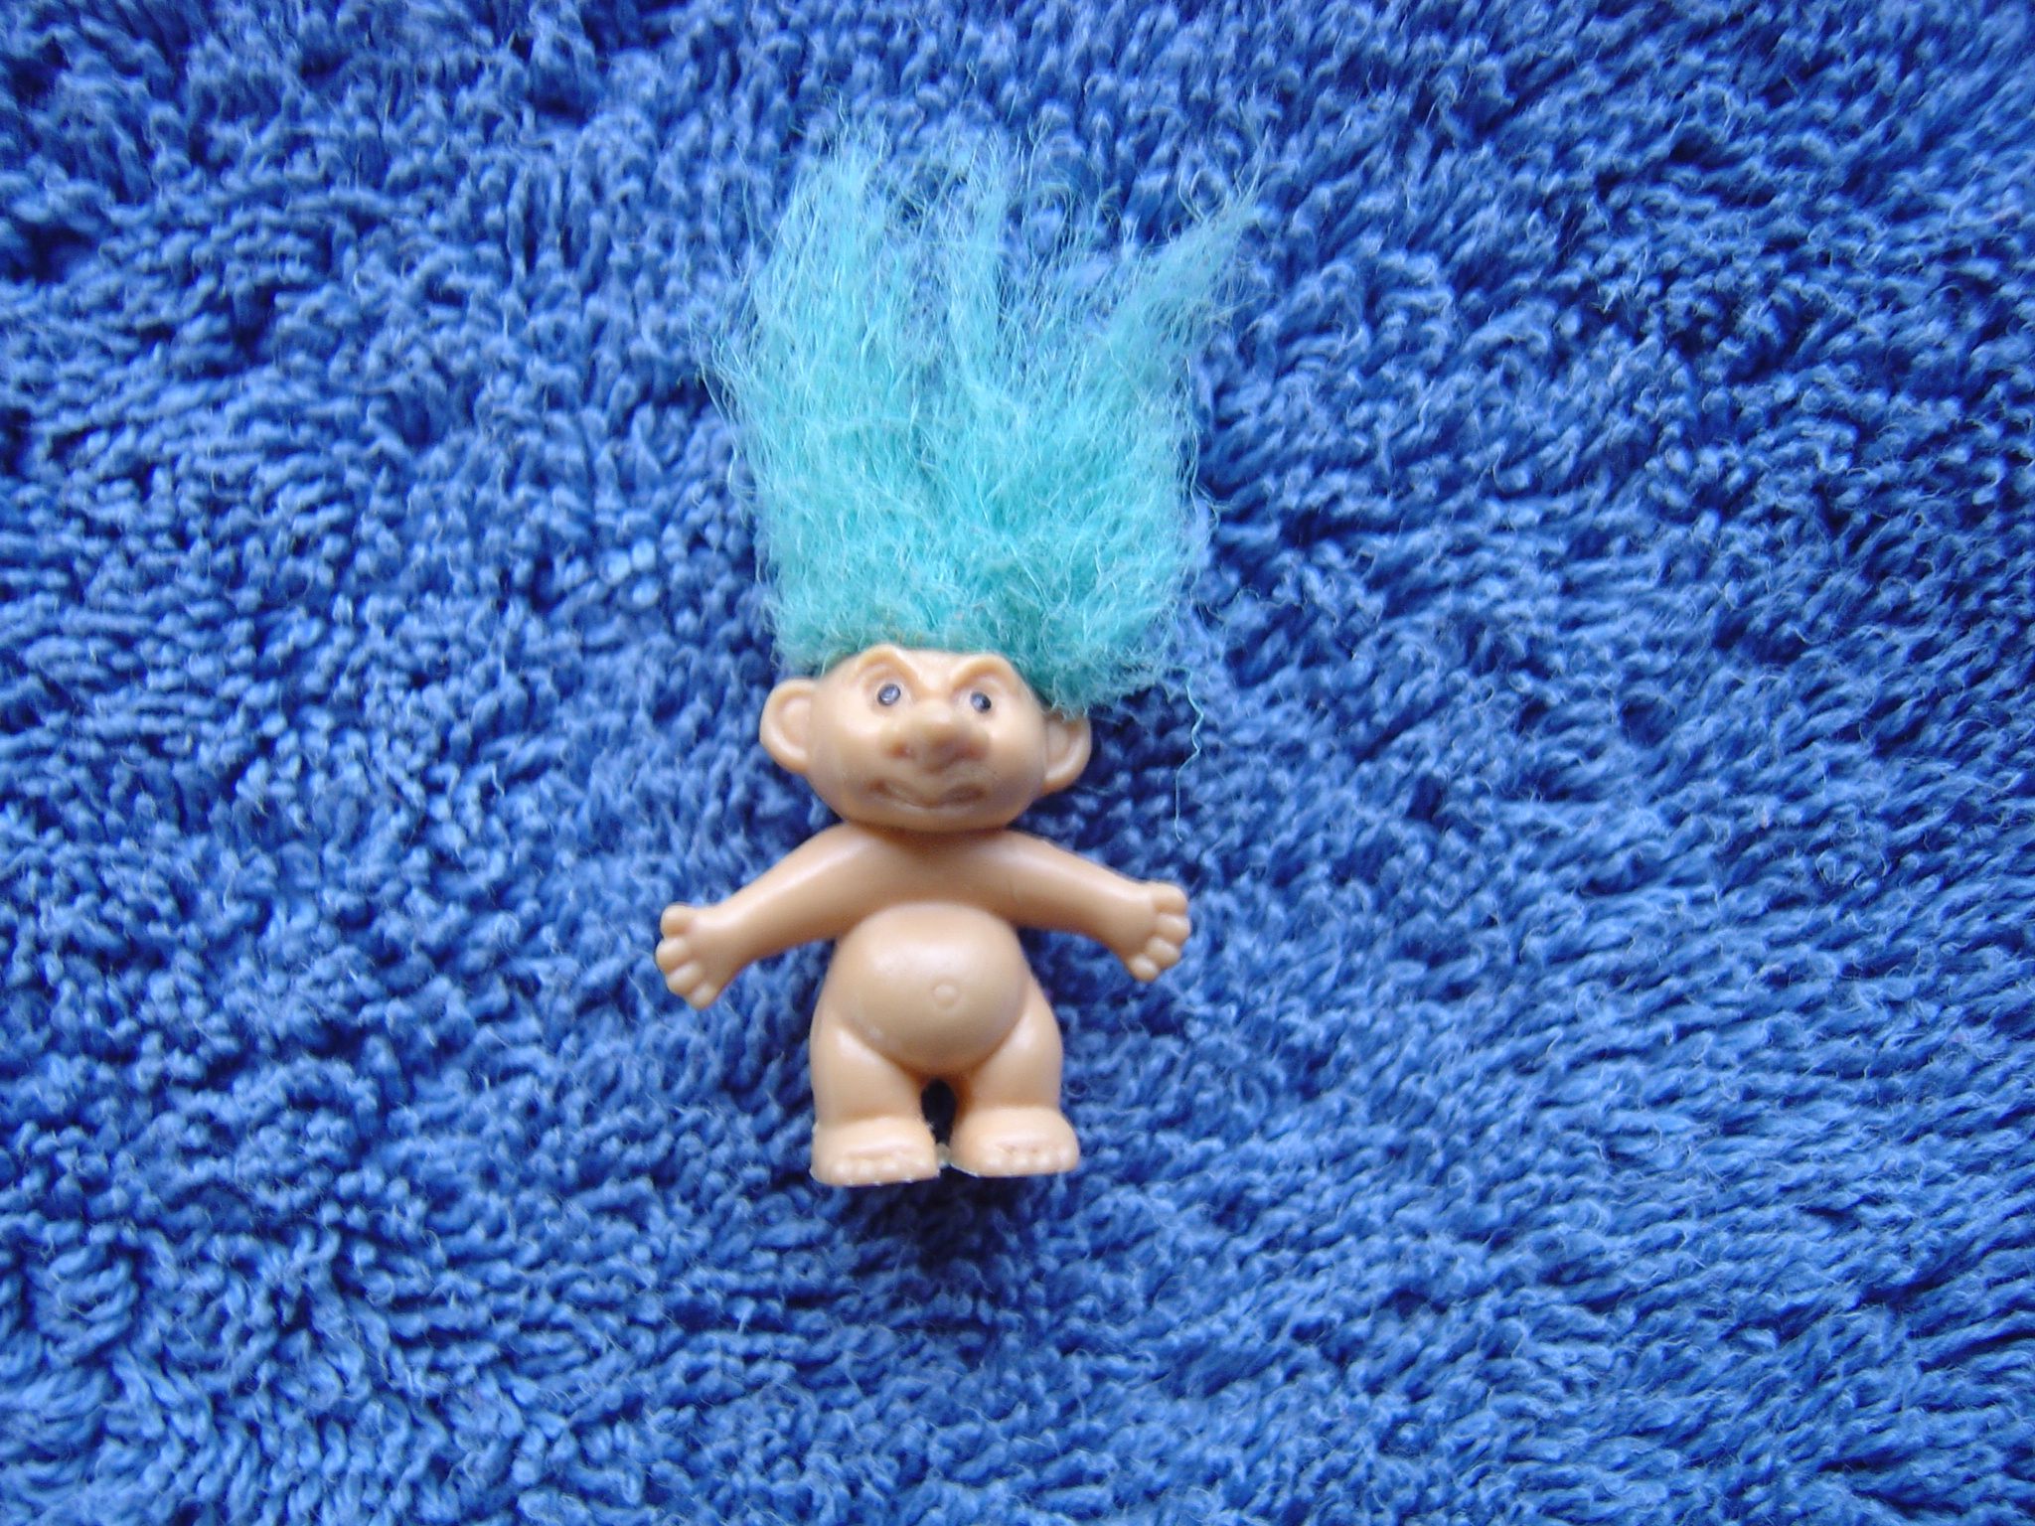

Slide 3
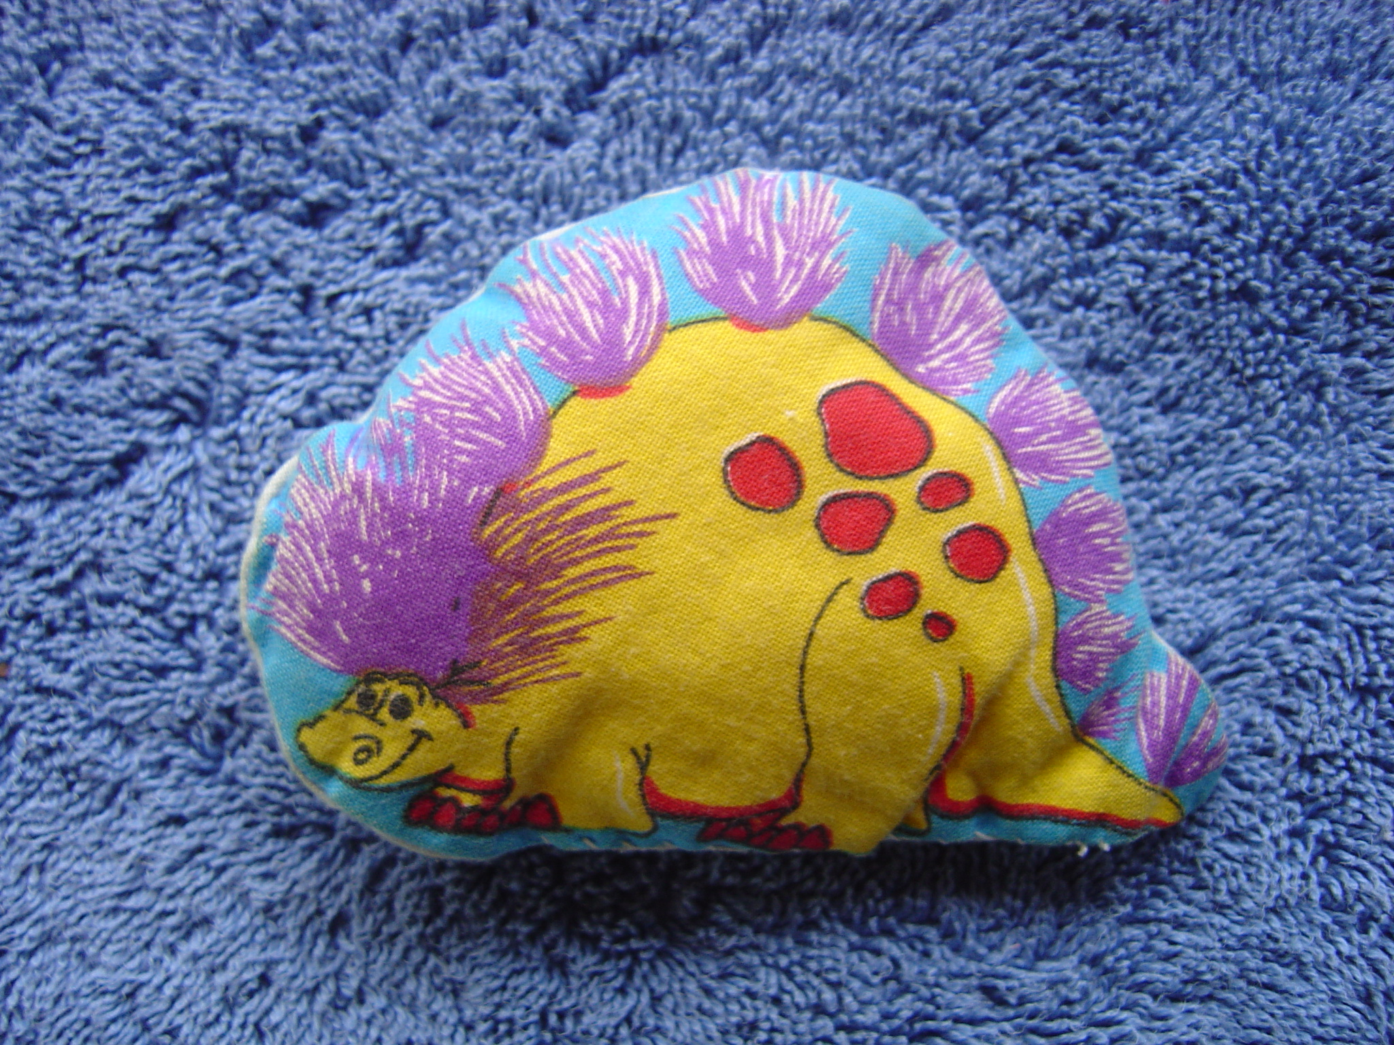

Slide 4
DISCOVER
CREATION
LANNY & MARILYN JOHNSON
ALPHA OMEGA INSTITUTE
P.O. Box 4343 • Grand Junction, CO • 81502
(970) 523-9943 • www.discovercreation.org

Slide 5
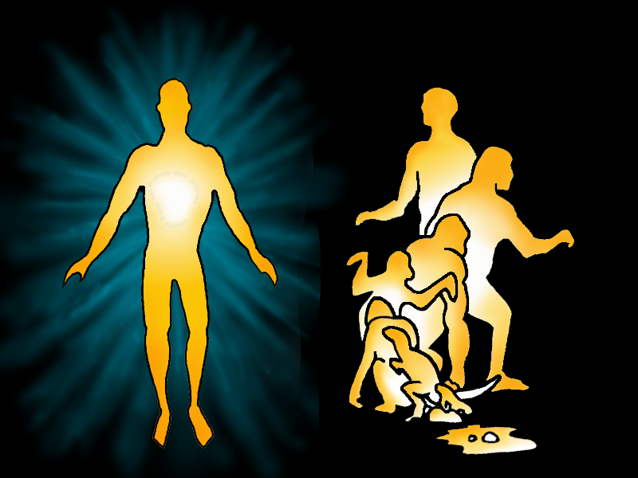
CREATION
EVOLUTION
M049

Slide 6
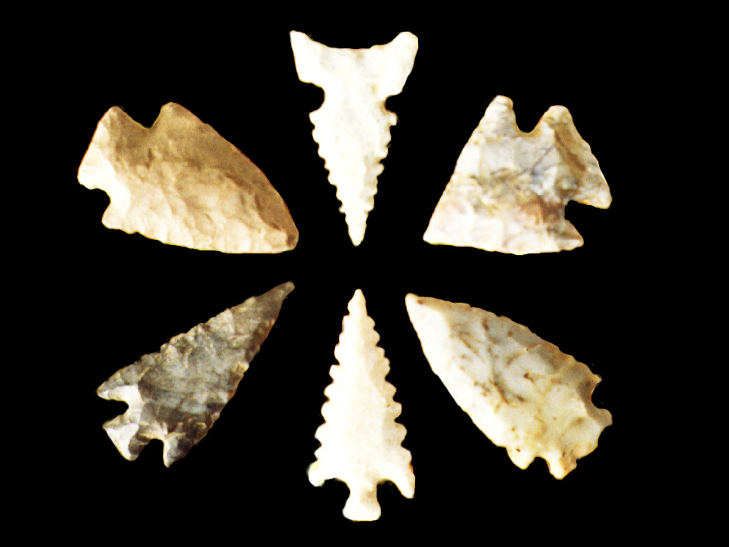
DE048

Slide 7
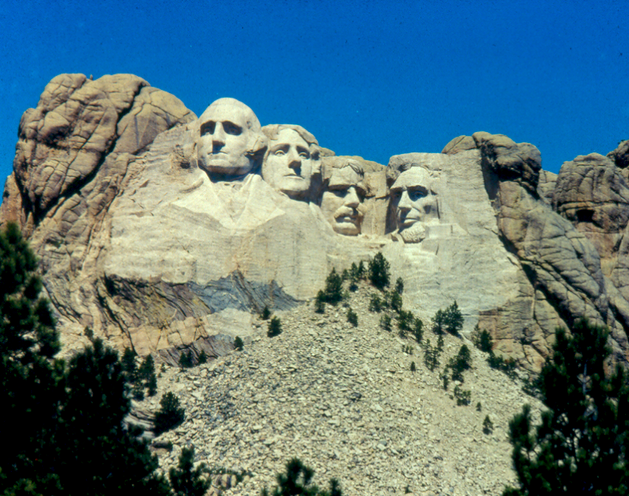

Slide 8
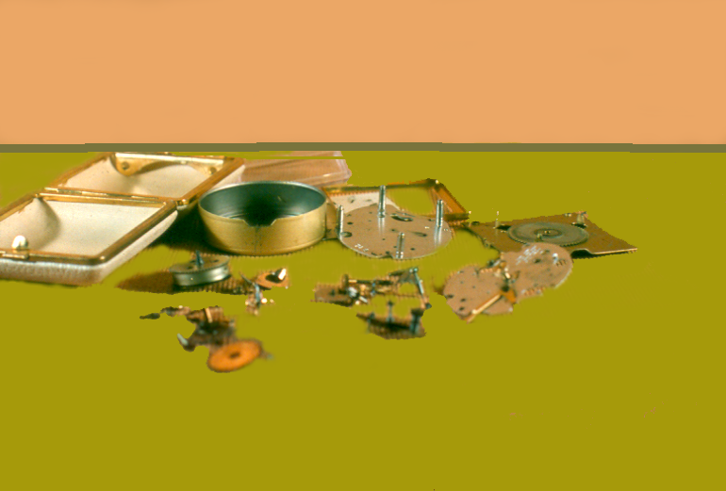

Slide 9


Slide 12

In the beginning God
created the heaven and
the earth.
Genesis 1:1

Slide 13
WHAT DOES
EVOLUTION TEACH?

Slide 15

OR050

Slide 16

OR067

Slide 17

OR068

Slide 18
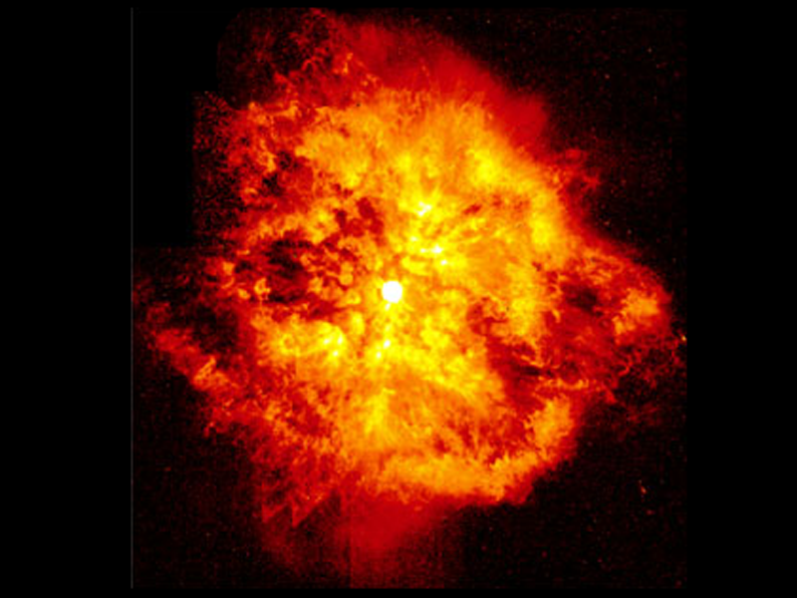

Slide 19
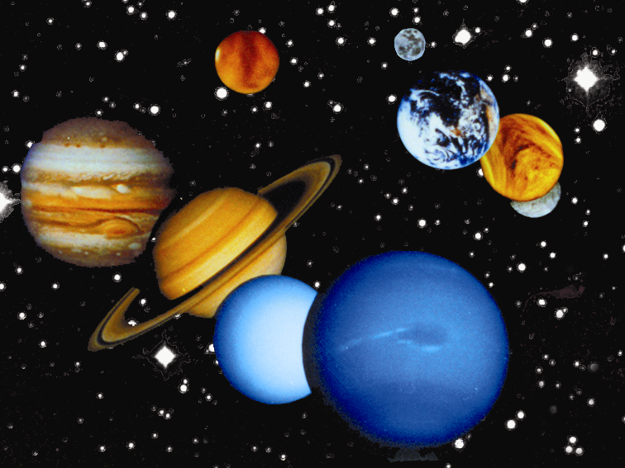
©AOI 2002

Slide 20
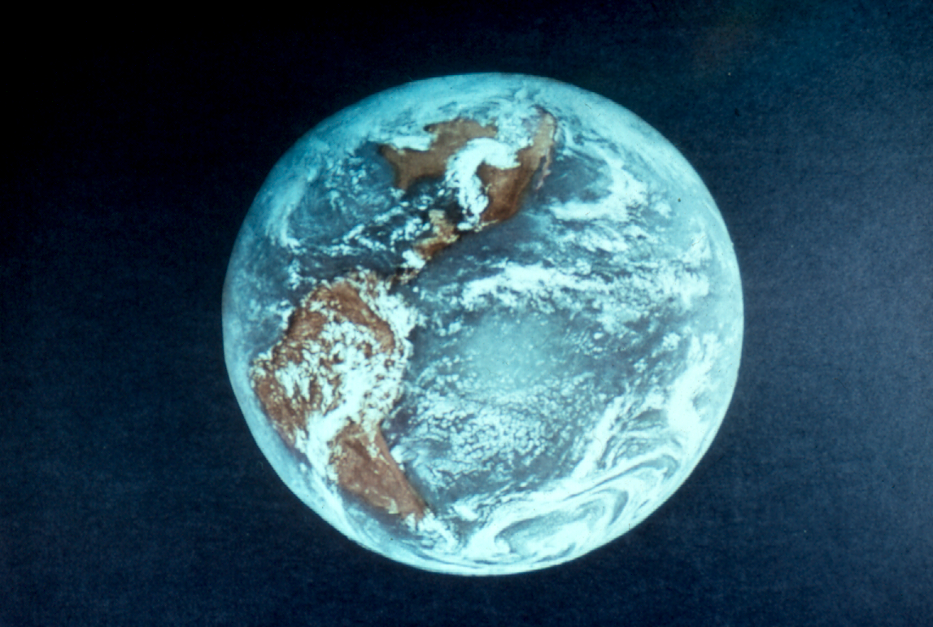
AS020

Slide 21
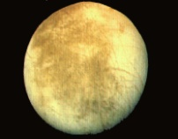

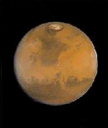
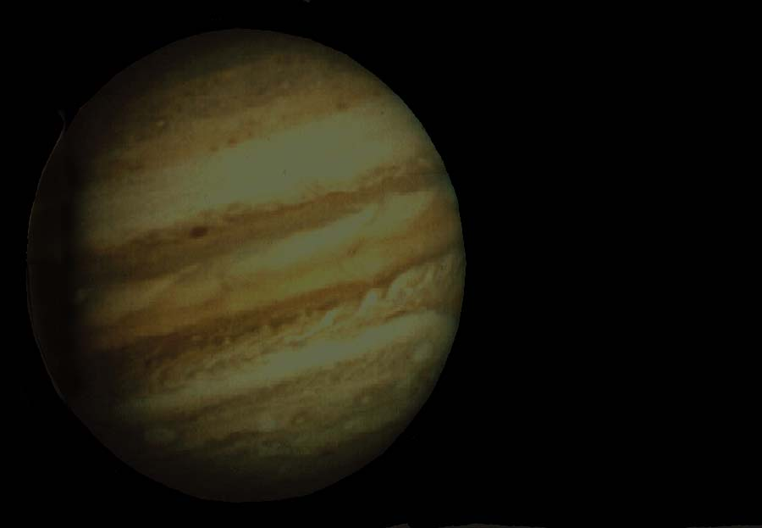
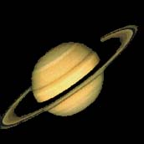

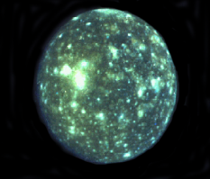

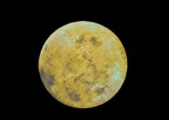
Mercury
Venus
Earth
Mars
Jupiter
Saturn
Uranus
Pluto
AS022
Neptune

Slide 22
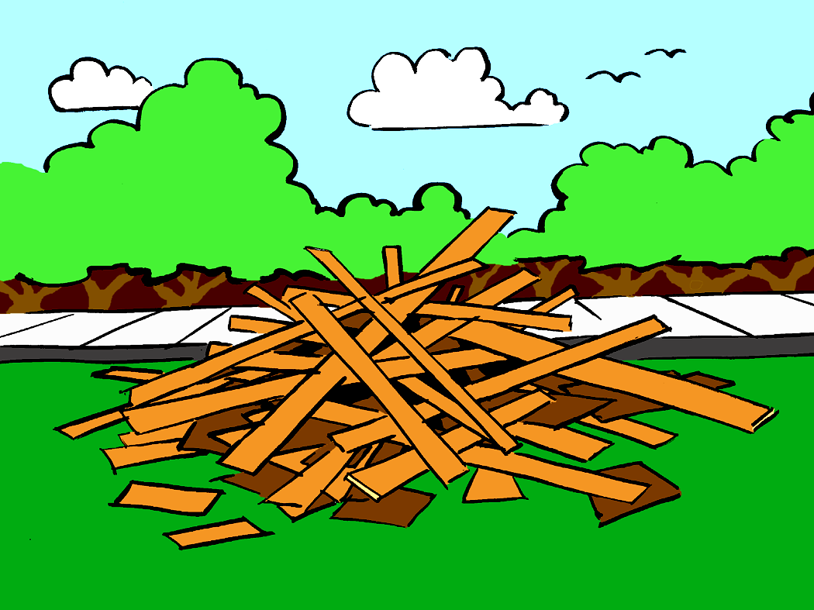
OR060

Slide 23

OR061

Slide 24

OR062

Slide 25

OR063

Slide 26


Slide 27

OR064

Slide 28
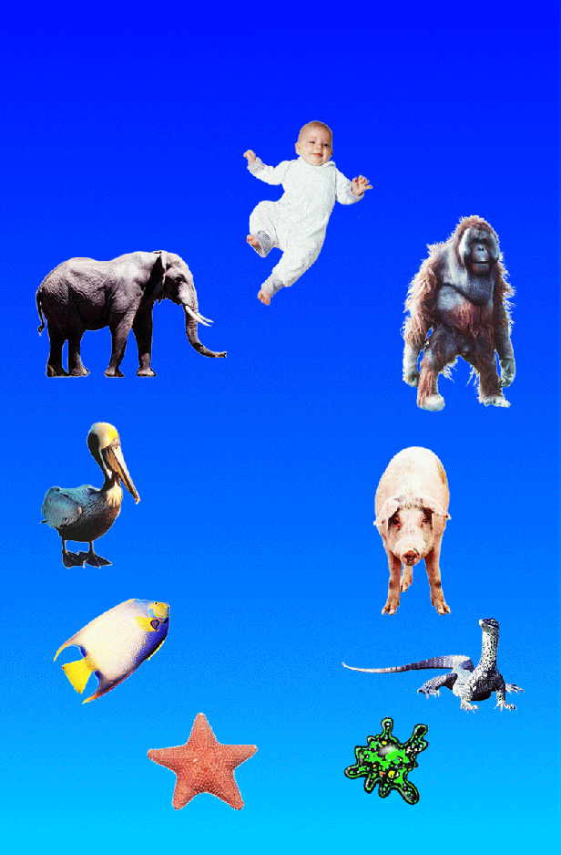
Evolutionary
Theory

Slide 29

OR065

Slide 30
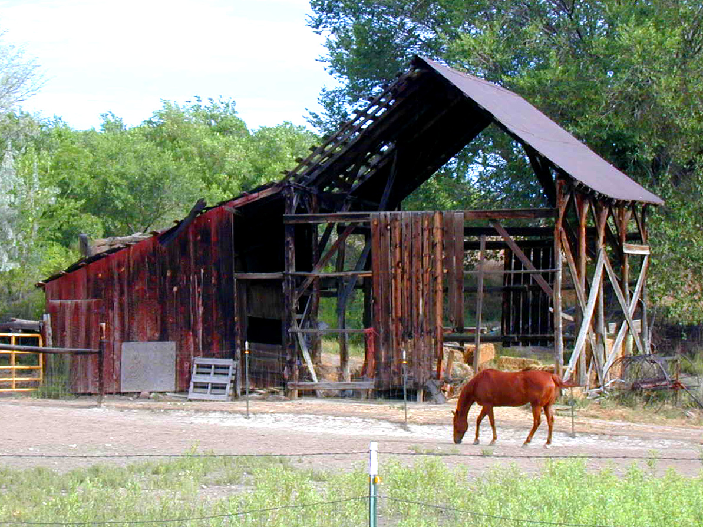
OR066

Slide 31
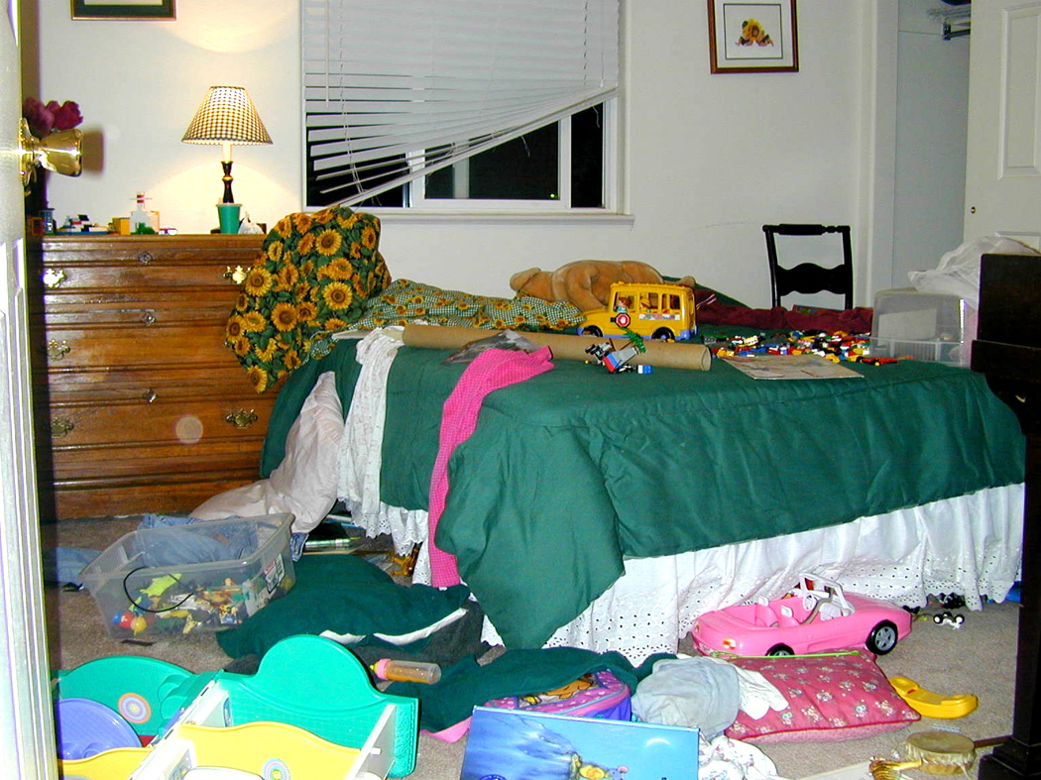
OR058

Slide 32
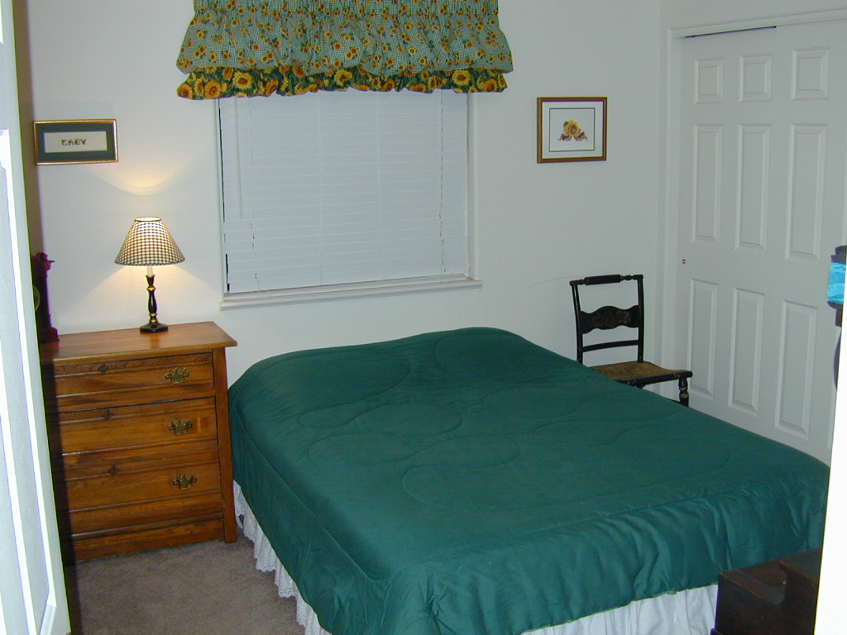
OR059

Slide 33
OR058

Slide 34
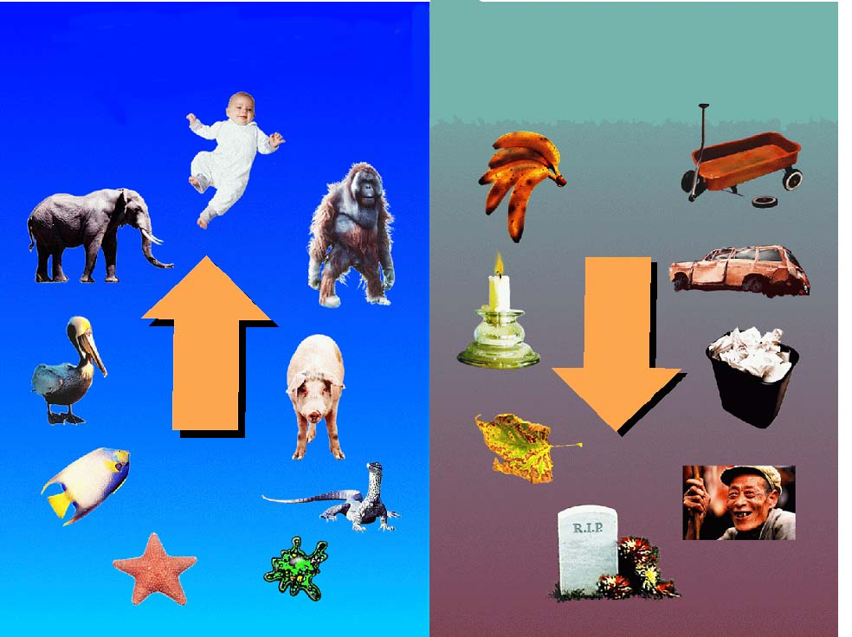
2nd LAW OF
THERMODYNAMICS
EVOLUTIONARY THEORY

Slide 35
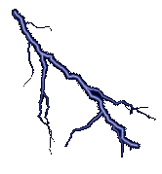
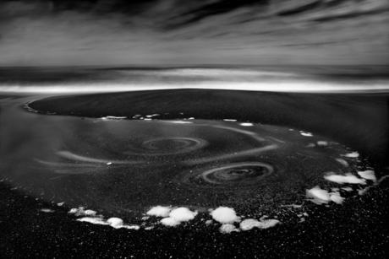
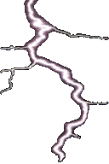

Slide 36
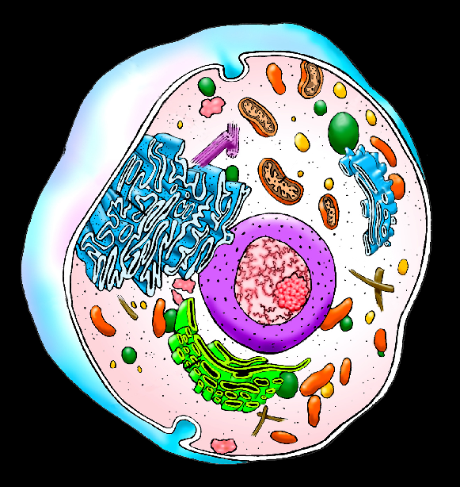

Slide 37
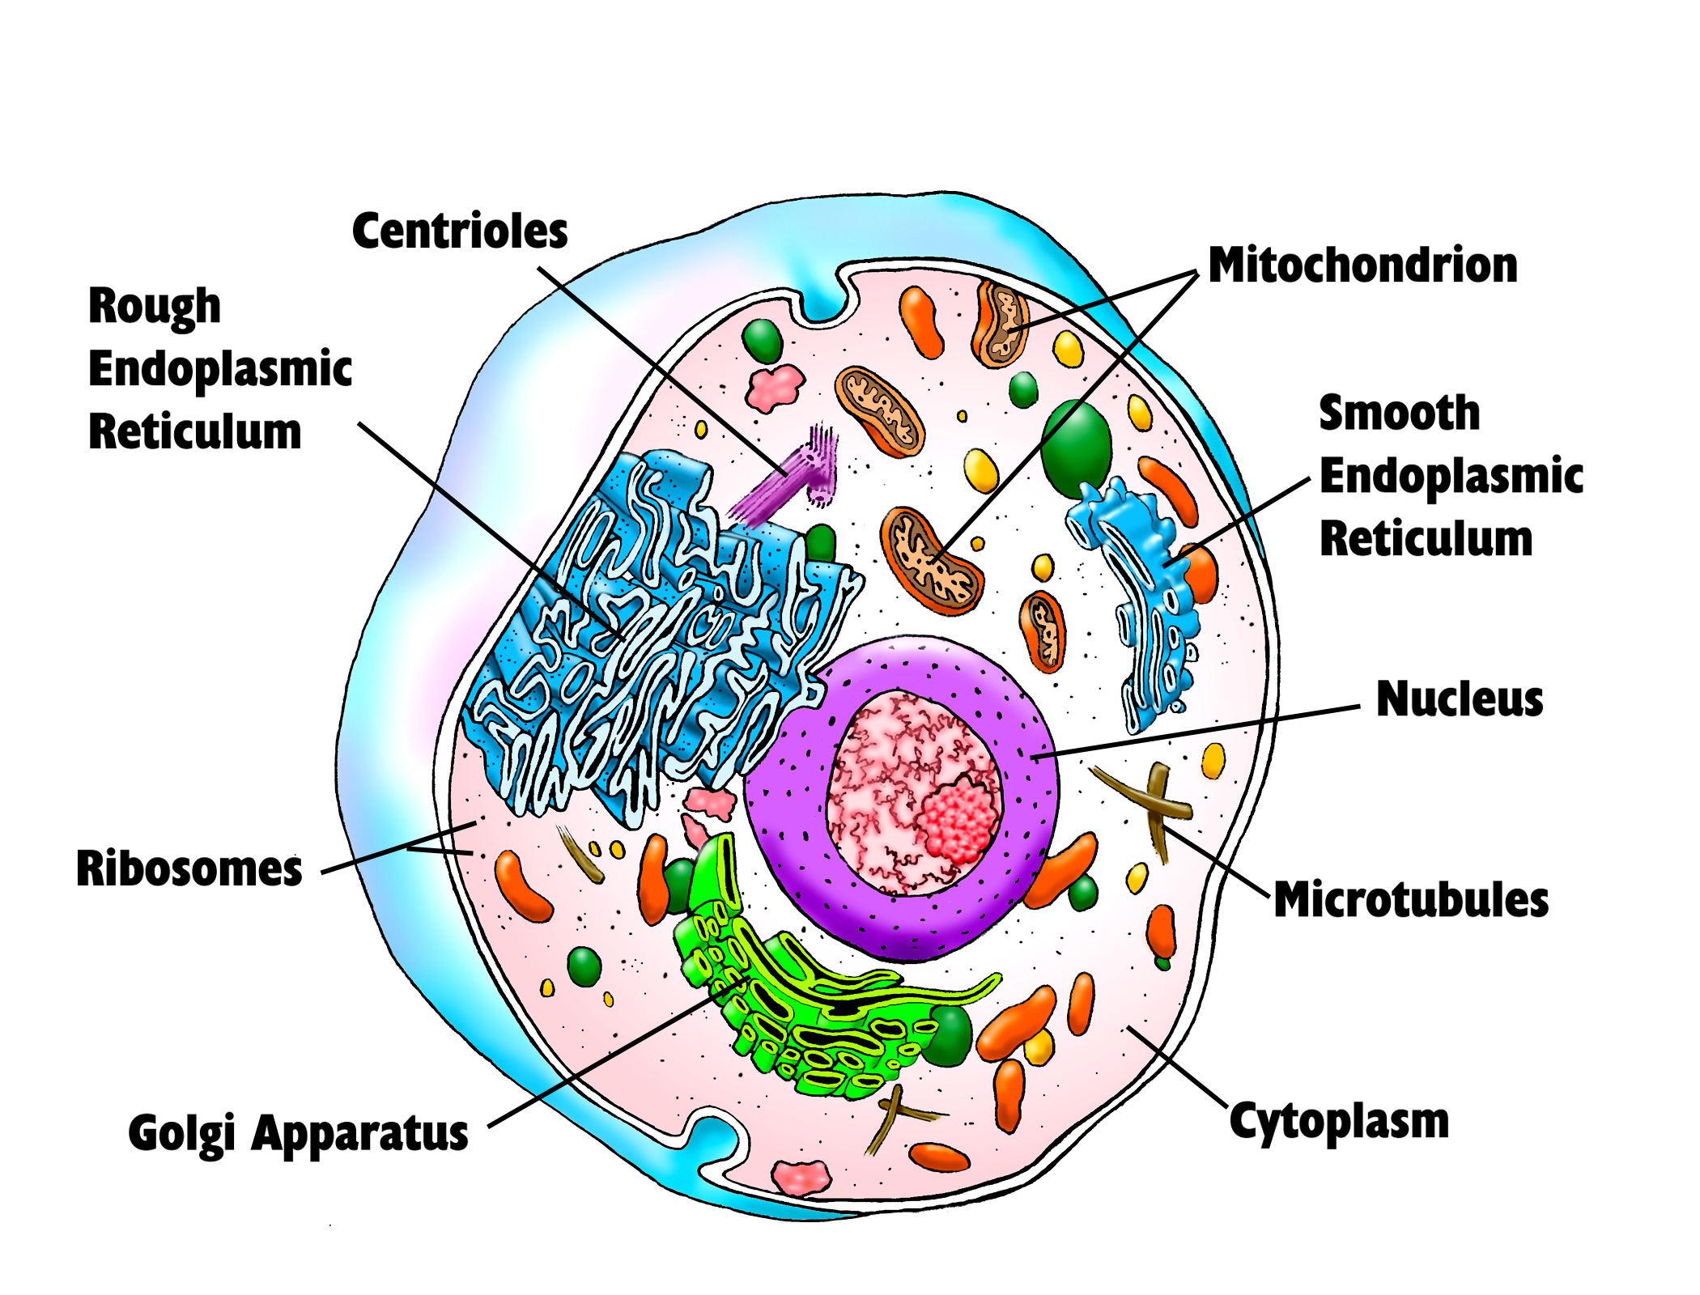
Human Cell
COULD THE CELL
HAVE HAPPENED BY
CHANCE AND ACCIDENT?
B008

Slide 38
Human Cell
B008

Slide 39


Slide 40
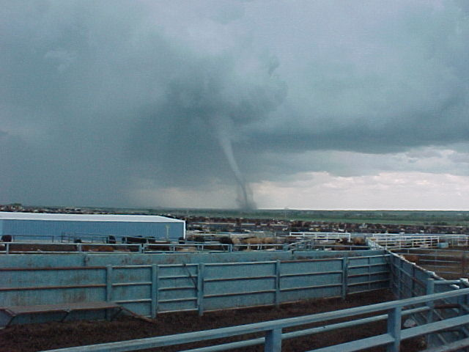
OR069

Slide 42
Probability for
life (cell):
1 chance in
10
40,000
Hoyle and Wickramasinghe
Notes:
10 to the 79th power electrons in universe (http://en.wikipedia.org/wiki/Electron)

Slide 43
Number of electrons
in the universe
(http://en.wikipedia.org/wiki/Electron)
10
79
10,000,000,000,000,000,
000,000,000,000,000,000,000,000,000,000,000,000,
000,000,000,000,000,000,
000,000,000
505
Notes:
10 to the 79th power electrons in universe (http://en.wikipedia.org/wiki/Electron)

Slide 44
Anything larger than 10⁵⁰ is considered to be impossible to happen by chance and accident.
Probabilities show that the odds
of life happening by chance and
accident are ZERO!

Slide 45
SONG
BREAK

Slide 46
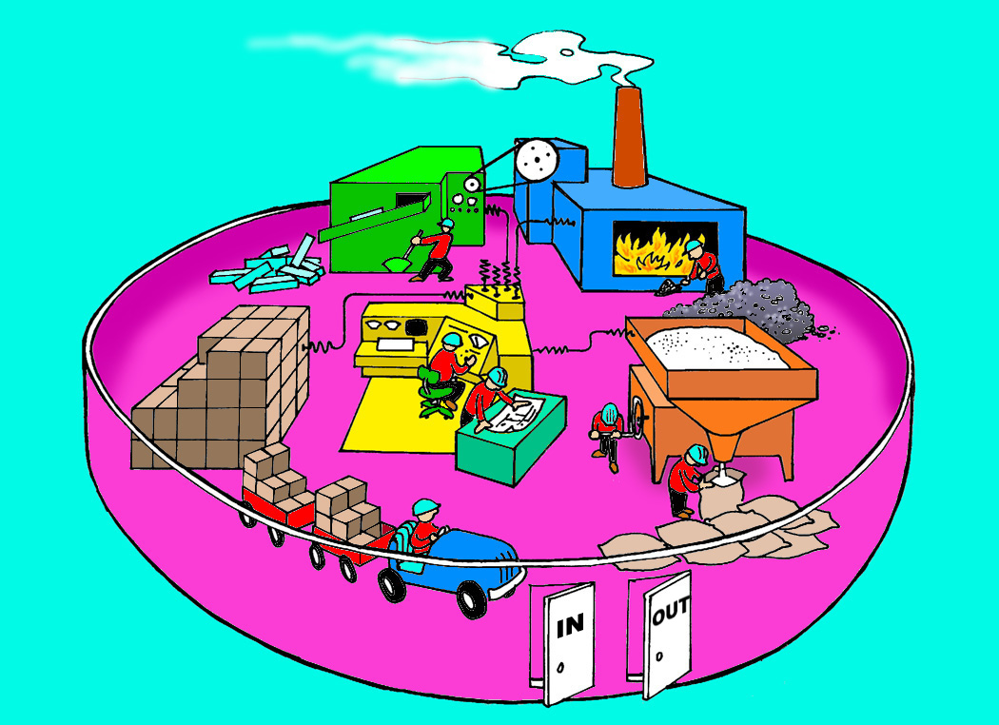
ST005

Slide 47

ST005

Slide 48


Slide 49

B052

Slide 50

B065

Slide 51


Slide 52


Slide 53
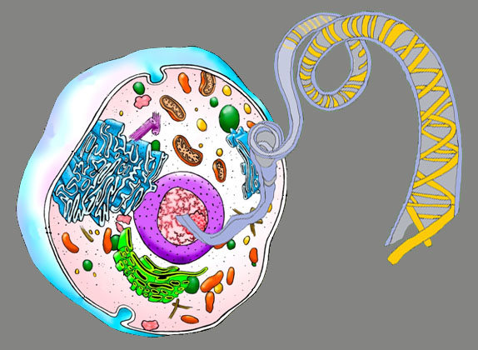

DNA
Cell
Nucleus
DNA
(deoxyribonucleic acid)
Chromosome
Notes:
The DNA in a single human cell is about 3 feet long and contains over 6 billion "steps." If all the DNA in a single human body were stretched out end-to-end, there would be over a billion miles' worth. (slide with stacks of books)

Slide 54
DNA
Cell
DNA
(deoxyribonucleic acid)
Nucleus
- In a single cell is about 3 feet long
- Contains over 6 billion “steps”
- If all the DNA in a single human body were laid end-to-end, they would stretch out over a billion miles
Chromosome
Notes:
The DNA in a single human cell is about 3 feet long and contains over 6 billion "steps." If all the DNA in a single human body were stretched out end-to-end, there would be over a billion miles' worth. (slide with stacks of books)

Slide 55
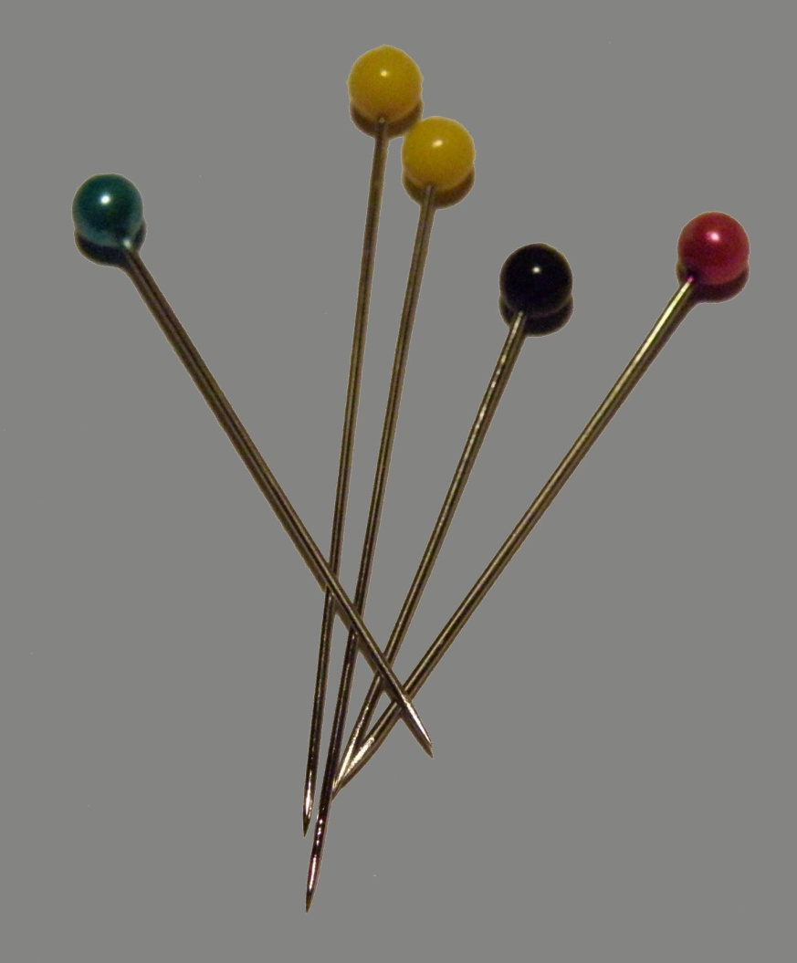
Take enough DNA from your
cells to fill one pin head …
Then reading all the information
on that DNA and typing it into
book form …

Slide 56

Would result
in 500 stacks
of books …
stretching to
the moon!

Slide 57

OR054

Slide 58
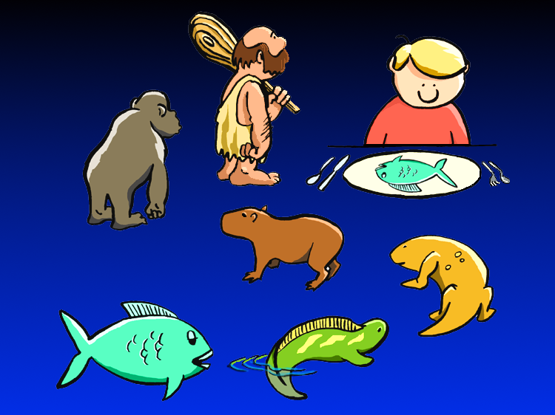
OR034

Slide 59
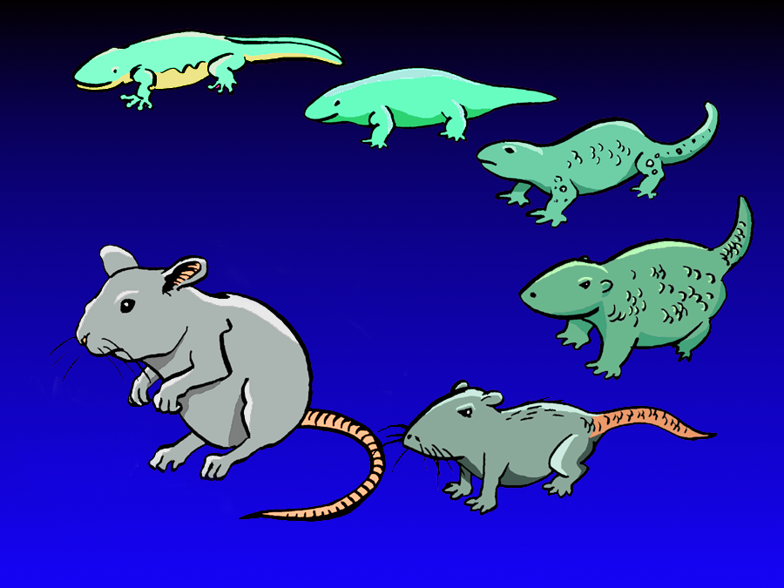
OR030

Slide 60
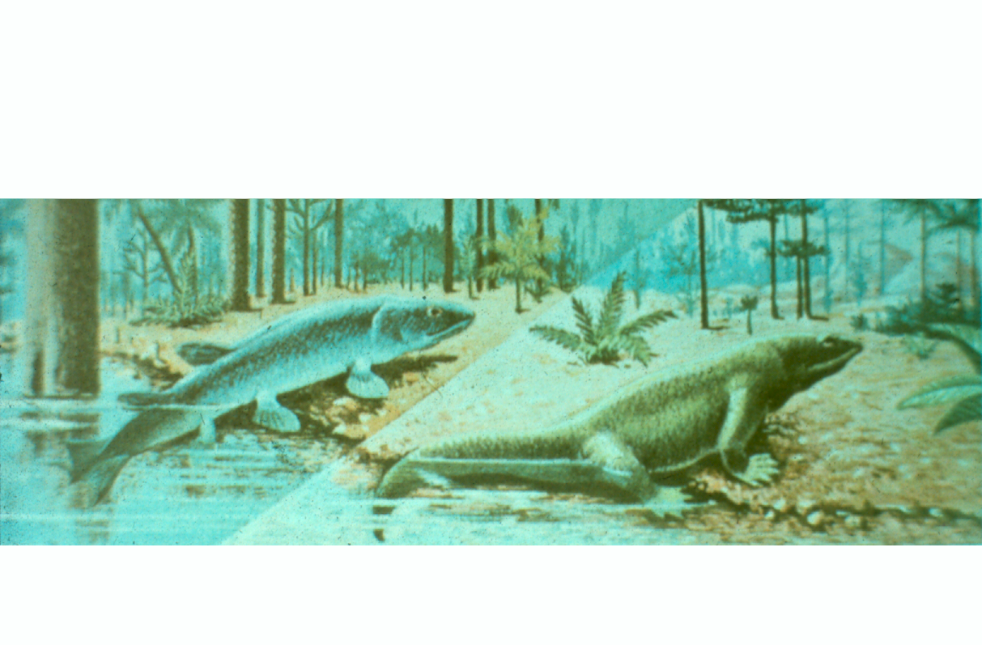
“missing links,” show how the process took place.
A Devonian lobefin crossopterygian
fish climbs ashore
Labyrinthodont amphibian, a decendant, goes ashore clumsily
RANDOM NATURAL SELEC-
TION, the critics once argued,
52-53) show that change from
one major group to another was
F007

Slide 61
B057

Slide 62
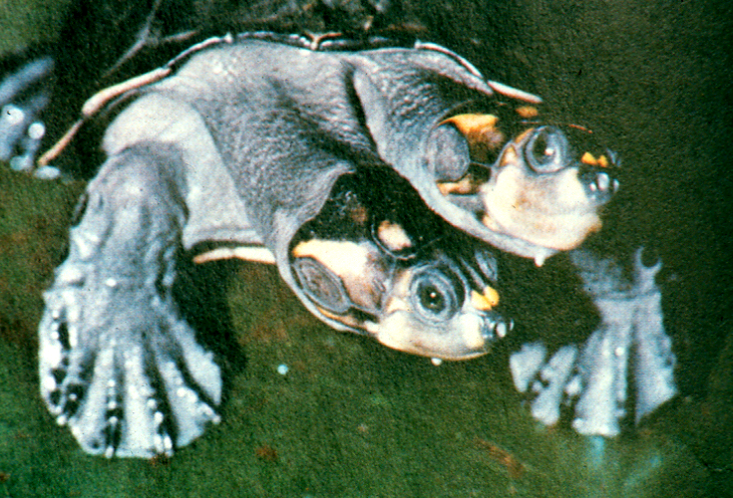

Slide 63
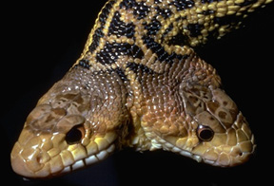

Slide 64
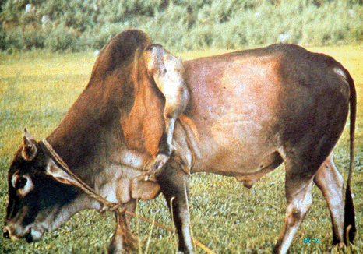

Slide 65

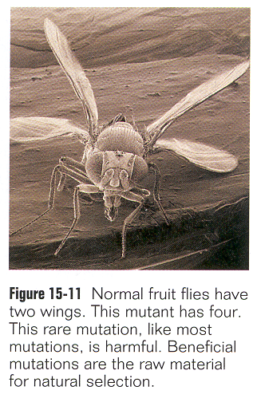
1996,
p. 324
Why don’t they give an example of a beneficial mutation ?

Slide 66

MICRO - EVOLUTION
≠ MACRO - EVOLUTION

Slide 67
©AOI 2002

Slide 68
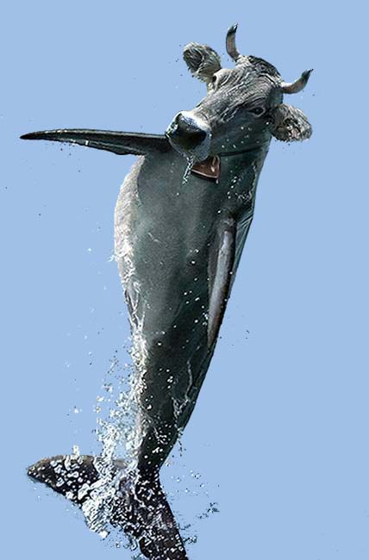
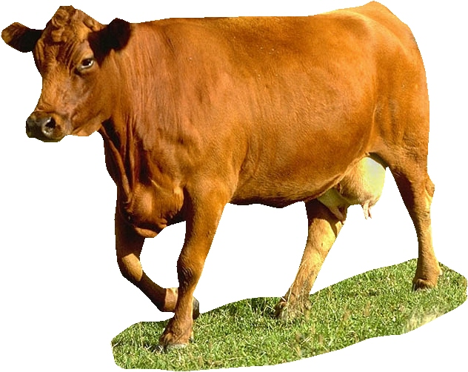
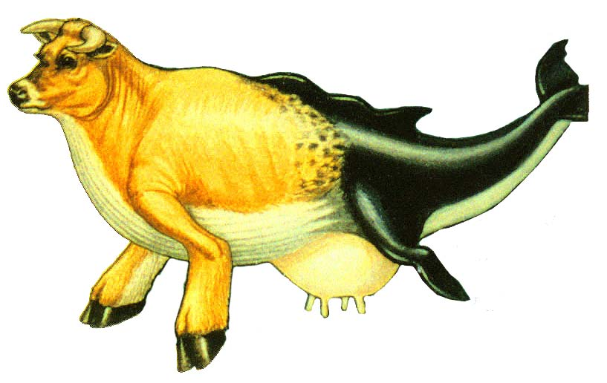
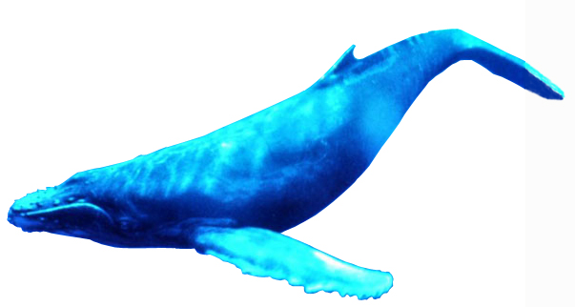

Slide 69
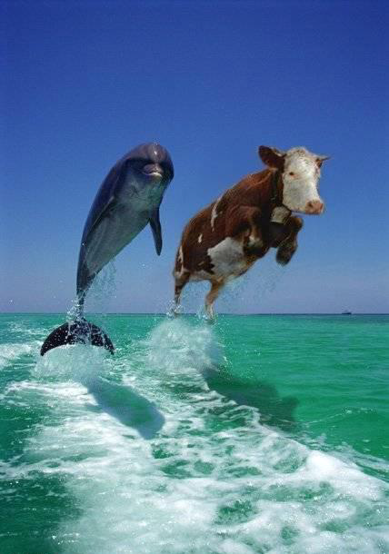

Slide 70
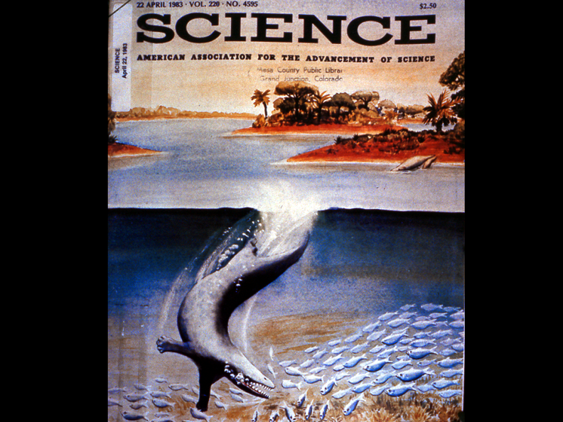
©AOI 2002

Slide 71
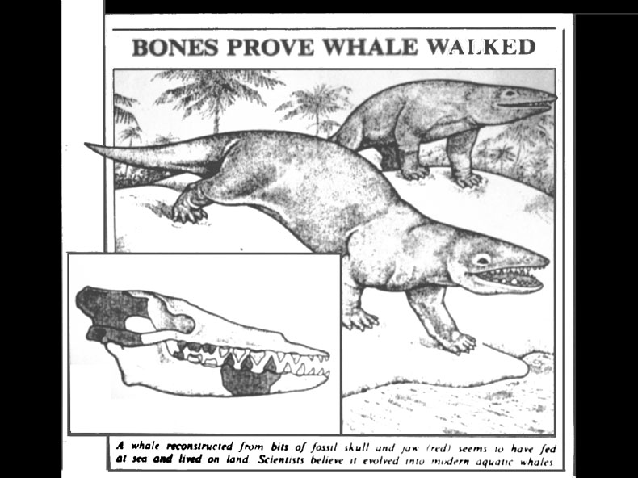
F025

Slide 72
©AOI 2002

Slide 73
For Information and
Seminars contact:
Alpha Omega Institute
P.O. Box 4343
Grand Junction, CO
81502
(970) 523-9943
www.discovercreation.org

